Slide 1
4
Chapter Four
The IMC Planning
Process
Notes:
Planning must occur before developing advertising and other marketing messages. This chapter presents the IMC planning process.

Slide 2
PetSmart
4
Pets are now part of the family.
Attitudes have changed.
New animal care products.
New animal care services.
Prices are secondary.
Why the Change?
Discussion Slide
Notes:
Pets have become a very important part of many people’s lives. For many, they are part of the family. Attitudes and the way pets are treated have changed. New animal care products have arisen. There are new services for pet care. For many, price is not important. Caring for and providing for their pet is paramount. The pet industry is now $41 billion. PetSmart has been a part of this evolution since its founding in 1986 by Jim and Janice Dougherty. In 1988 PetSmart sold its first pet sweater and emphasized cutting down on the pet population. In 2000, it changed its corporate vision “to provide total life-time care for every pet.” Then in 2005, PetSmart opened a series of pet hotels.

Slide 3
Chapter Objectives
4
The IMC Planning Process
How can the three Cs of the IMC planning context form the basis for an effective advertising program?
What categories are used to identify consumer and target markets or market segments?
What categories are used to identify business-to-business market segments?
How do the various approaches to positioning influence the selection of target markets?
Notes:
These are the objectives for Chapter 4.

Slide 4
Chapter Objectives
4
The IMC Planning Process
How do the marketing communication objectives interact with the other elements of the IMC planning process?
What are the relationships between communications expenditures and company sales?
What types of marketing communications budgets may be used when developing the IMC planning program?
In addition to advertising, what other IMC components are selected as part of the IMC planning process?
Notes:
Additional objectives for Chapter 4.

Slide 5
Chapter Overview
The IMC Planning Process
4
IMC planning
Target markets
Market segmentation
Positioning strategies
Communication objectives
Budget
IMC components
Notes:
The IMC planning process involves a number of steps and decisions. Planning begins with research, decisions about target markets, market segmentation, and positioning. Once these factors are investigated and decisions made, then communication objectives can be created. A budget is then appropriated. The last part of the planning process is to think about the IMC components and how they will work together to create synergy.

Slide 6
F I G U R E 4 . 1
The IMC Planning Process
Target
Market
Budget
Context
Customers
Competitors
Communication
Objectives
Product
Positioning
IMC
Component
Notes:
The IMC planning process begins with an analysis of the context, which involves the 3 C’s – customers, competitors, and communication. From the analysis of the 3 C’s, decisions about the target market and product positioning can be made. It is a joint decision because one affects the other. Next communication objectives are formulated. From the objectives come the budget and a selection of the appropriate IMC components. Again, it is a mutual decision because the budge impacts which IMC components can be used and the selection of the IMC components affects the budget.

Slide 7
Customers The IMC Planning Process
Current customers
Former customers
Potential new customers
Competitors’ customers
Notes:
The customer analysis involves looking at 4 different types of customer groups. The most obvious group is current customers. They will be the easiest to study. But, former customers are important, especially learning why they are former customers and why they switched to another brand. Potential customers is an important group to understand because this may be a primary group to be targeted with an advertising or marketing campaign. The last group is the competitors’ customers. Why do they purchase from the competition and what would it take to get them to switch? In designing ads, it is important to know which group is being targeted. This MTA ad is targeted to individuals who have not yet purchased Mud Trax tires.

Slide 8
Competition The IMC Planning Process
Identify major competitors.
Identify communication strategies and tactics of each competitor.
Sources of information
Primary research
Secondary data
Research what others say
Notes:
The second phase of the company context analysis is examining competitors. The process should start by identifying major competitors, a firm’s most direct competitors. Then examine each competitor’s communication strategies and tactics. What are they telling their customers? How are they communicating with customers? While the goal is not to copy what the competition does, it is important to know what they are doing. Sources of information include primary sources, secondary data, and what others say. Often primary research can be conducted by visiting competing businesses or buying their products. Searching the library for information can provide a wealth of information. Learn what is being written about the company by others.

Slide 9
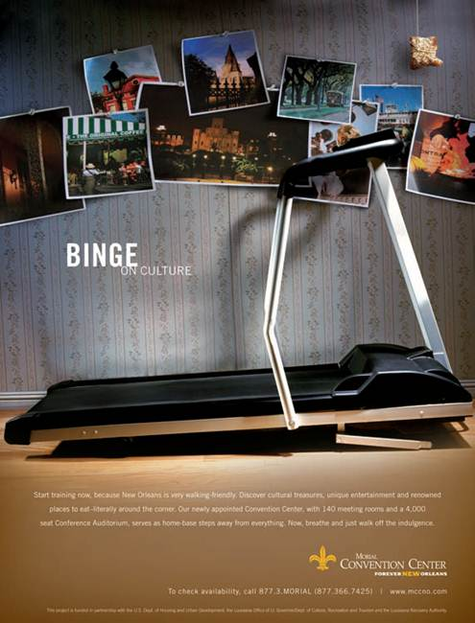
Communications The IMC Planning Process
Company communications
Industry communications
Competitor communications
Notes:
The 3rd component of the analysis is examining communications. It is important to know what the company is communicating to customers, channel members, employees and other stake holders about the brand. A further focus should be on the communications used in the industry and by competitors. All of this information provides guidance to marketers in developing an integrated marketing campaign.

Slide 10
Target Markets
Target markets
Consumer markets
Business-to-business markets
Market segment
Market segmentation
Notes:
Once the context analysis is complete, the marketing group can focus on the target market or markets. There may be target segments that no one is reaching or communicating to. There may be target markets that are being served by competitors, but not very well. Other target markets may be saturated with options. Part of the decision on target markets is the segmentation approach that will be used and the product positioning strategy. While there may be some flexibility with some target markets, others will require a specific positioning strategy because of competitors. This advertisement by Ouachita Independent Bank is designed to speak to individuals who want a bank they can trust, implying a local bank is more trustworthy than a national or regional chain bank.

Slide 11
Tests to Determine if a Particular Market Segment Is Viable
The individuals or businesses within the segment are homogeneous.
The market segment is different from the population as a whole and distinct from other market segments.
The market segment is large enough to be financially viable to target with a separate marketing campaign.
The market segment must be reachable through some type of media or marketing communications method.
Notes:
To be a viable market segment, it must meet four criteria. First, the individuals or businesses within the segment should be homogeneous, that is they should be alike. Second, the market segment must differ from the general population and also be different than other market segments. Third, the market segment has to be large enough to be financially viable to support a separate marketing campaign. While some market segments meet the first two criteria, they are too small to support a different campaign. The last criteria, the market segment must be reachable through some type of media or marketing communications method. There are some market segments in Africa and other parts of the world that meet the first three criteria, but not the fourth. There is no feasible way to reach them with a marketing message.

Slide 12
F I G U R E 4 . 2
Methods of Segmenting Consumer Markets
Demographics
Psychographics
Generations
Geographic
Geodemographics
Benefits
Usage
Notes:
Consumer markets can be segmented, or divided, along a number of dimensions. The most common is demographics because it is the easiest. Other methods used include psychographics, generations, geographic, geodemographics, benefits, and usage.

Slide 13
Gender Segments Based on Demographics
Gender based products
Gender difference in communications
Female consumers
Control 66% of spending ($12 trillion)
Involved in purchasing high-priced electronics (96%)
Deal with financial advisors (90%)
Buy and sell stocks (80%)
Household’s primary accountant (70%)
Notes:
Gender is a common demographic segmentation variable because there are significant differences between males and females and because it is easy to identify each market segment. Men and women purchase different products. They also use the same products, but in different ways. The way marketers communicate to the genders can vary. For instance, females now control about $12 trillion in spending, or 66%. The are involved in product purchases that in the past were dominated by males. For example, 90% of women are involved in purchasing high-priced electronics, 90% deal with financial advisors, 80% buy and sell stocks, and 70% are their household’s primary accountant.

Slide 14
F I G U R E 4 . 3
Tips for Marketing to Women
Focus on how brand can improve life
Engage them with the brand
Focus on practical, not trivial
Tell a story that resonates
Provide details
Be positive
Notes:
In marketing to women, a few tips should be observed. 1) The focus should be on how the brand can improve the woman’s life, not on what the brand can do. 2) It is important to engage the female with the brand, make them feel a part of the brand. 3) Focus on the practical, not on trivial. Women want to know the facts and how it can benefit them, not on bizarre, unique features to impress. 4) Tell a story that resonates. Women like stories, they like brands that create feelings and emotions among people. 5) Provide details. While it may seen unimportant, it is. Women want all of the information so they can make a good decision. 6) Be positive, negative selling doesn’t work.

Slide 15
A Bijan advertisement targeted to females
Notes:
This ad for Bijan highlights the fact that not all women are alike. So in marketing to females, a company will need more information. That is where some of the other segmentation variables come into play.

Slide 16
BMW Motorcycle ad directed to men as the primary purchaser and women as the decision-making influencer.
Notes:
Through in-depth interviews and focus group research, BMW Motorcycles learned a great deal about differences between men and women when it came to motorcycles. Men were seen as the primary purchaser. They finalized the deal, often appeared to make the final decision. But women were a very important influence on the decision. If the female did not like a particular brand, it was not likely to be purchased. Women were more concerned about comfort, feel, and looks while men were more concerned about the mechanical aspect of the cycle.

Slide 17
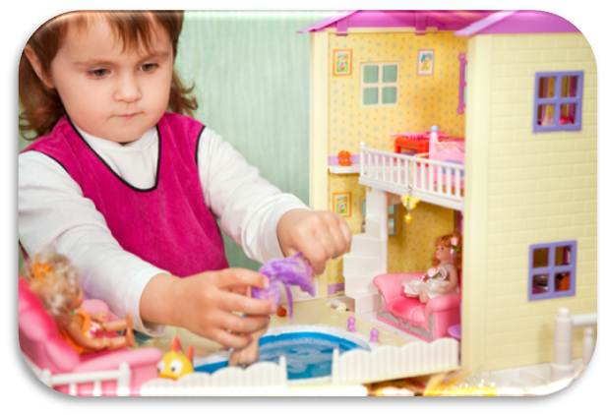
Age Segments Based on Demographics
Target specific age group
Combine with other demographic variables
Children attractive group
Notes:
Age is another demographic variable that is easy to use for segmentation. Obviously, there is a huge difference in the products children use versus the products adults use. Differences are also present between someone 20 and someone 70. Few marketing messages resonate with all age groups. Therefore, focus on a specific age group. Age segmentation often works well when combined with another demographic variable, such as males ages 20 to 35, or females 18 to 40. One age group that is attractive to marketers is children. They spend $30 billion a year themselves and influence another $500 billion. It is not just toys they influence. Children influence parents on the purchase of everything from food to cameras to furniture to vehicles.

Slide 18
Segments Based on Demographics
Income
Ethnic groups
Ad directed to “exhausted affluent”
Notes:
Other demographic segmentation variables include education, income, and ethnic groups. Each can be used alone, or combined with other demographic variables to create smaller, more homogeneous segments. This ad for Thomasville furniture is directed to a segment called the “exhausted affluent.” The exhausted affluent bridge the gap between the haves and the have nots. They desire style and quality, but not something overly fancy.

Slide 19
Psychographic Segmentation
Describe consumers
AIO measures
Activities
Interests
Opinions
Combine with demographic profiles
Notes:
Demographics are relatively easy to identify, but they do not fully explain consumer purchase behavior. Psychographics are an individual’s activities, interests, and opinions. They help marketers to understand why consumers buy what they buy. Psychographics are often combined with demographic profiles to provide a much richer description of a target segment.

Slide 20
VALS 2 Psychographic Segmentation
Innovators – successful, sophisticated – upscale products
Thinkers – educated, conservative, practical – durability, value
Achievers – goal-oriented, conservative, career, and family
Experiencers – young, enthusiastic, impulsive, fashion, social
Believers – conservative, conventional, traditional
Strivers – trendy, fun-loving, peers important
Makers – self-sufficient, respect authority, not materialistic
Survivors – safety, security, focus on needs, price
Notes:
A well-known measurement of psychographics is the VALS2 typology. Consumers are divided into 8 different segments based on their AIO measures (activities, interests, and opinions). This type of information helps marketers design more effective communication. For instance, reaching achievers requires ads that stress careers, families, goals, and a conservative lifestyle. On the other hand, reaching experiencers requires ads to convey youthfulness, enthusiasm, impulsiveness, fashion and social acceptance.

Slide 21
FIGURE 4 . 4
Characteristics of Generation Segments
Name of Segment Year of Birth Characteristics
Millennials | 1978-2002 | Spend money on clothes, automobiles, college, televisions, and stereos. Ninety percent live at home or in a dorm or rent an apartment.
Generation X | 1965-1977 | Focus on family and children. Spend on food, housing, transportation, and personal services.
Younger Boomers | 1954-1964 | Focus on home and family. Spend on home mortgage, pets, toys, playground equipment, and large recreational items.
Older Boomers | 1952-1953 | Spend on upgrading homes, ensuring education and independence of their children, and luxury items, such as boats.
Seniors | Up to 1951 | Most have fixed incomes. Spend heavily on health care and related medical items.
Source: Author-created from Dana-Nicoleta Lascu and Kenneth E. Clow, Marketing Principles (Cincinnati, OH: Textbook Media Press, 2012).
Notes:
Markets can be segmented based on generations. This table shows the five major generation groups, when they were born, and primary characteristics of each group. The idea behind generation segmentation is that people who grow up experiencing common events will become similar in their AIO measures. These groups often enjoy the same music, foods, and products.

Slide 22
Ad targeted to seniors.
Notes:
According to generation segmentation, seniors have a fixed income and spend heavily on health care and related medical items. This ad by St. Francis Medical Center is targeted to seniors informing them they are first in orthopedics and foremost in hip replacement.

Slide 23
Geodemographic Segmentation
Combines
Demographic census data
Geographic information
Psychographic information
PRIZM
62 market segments
Southside City
Towns and Gowns
Notes:
Geodemographic segmentation combines demographic information, geographic information, and psychographic information. Geodemographic segmentation is beneficial for national firms conducting direct mail campaigns and for retailers in targeting customers in a geographic area around the store. The most well known geodemographic segmentation system is PRIZM. It consists of 62 different market segments. For every zip code in the United States, PRIZM identifies the market segments that reside there. For instance, in downtown Jackson, MS the two primary clusters are southside city and towns and gowns. The southside city cluster contains primarily young and elderly African-Americans, employed in low-paying blue collar jobs, with a lower level of education, who rent apartments, and read sports and fashion magazines.

Slide 24
Benefit Segmentation
Fitness Industry
Winners
Dieters
Self-improvers
Notes:
Benefit segmentation focuses on the advantages consumers receive from a product rather than the characteristics of the consumer. An excellent example of benefit segmentation is the fitness industry. People exercise for different reasons. The three most common benefit segments are winners, dieters, and self-improvers. The winners exercise because they like to exercise. It is a way of life for them. The dieters join a fitness center to lose weight, or maintain their weight. Self-improvers are there primarily because a physician told them to be there. They have experienced a medical problem and realize they must exercise to regain body functions or maintain their health.

Slide 25
Usage Segmentation
Usage or purchase history
Create clusters
Target specific clusters
Create marketing programs for each cluster
Measure growth and migration
Notes:
Usage segmentation focuses on how consumers use a product or on their purchase history. Marketers can create clusters of heavy users, light users, or any other category of users. By dividing the market in terms of usage, companies can target a specific cluster creating a unique marketing approach. The message to a light user of a product will certainly be different than a heavy user of a product. One of the goals of targeting light or average users is to move them up into a higher group in terms of usage.

Slide 26
F I G U R E 4 . 5
Methods of Segmenting B-to-B Markets
Industry (NAICS/SIC codes)
Size of business
Geographic location
Product usage
Customer value
Notes:
Segmentation in business-to-business markets can be based on industries, size of businesses, geographic location, product usage, or customer value. Because most businesses have records of their business customers, segmentation is often easier than with consumers, at least in identifying customers. NAICS codes are one of the most popular methods of segmentation because the federal government has developed the code and there are lists of businesses within each code. Segmentation based on size is necessary when a firm wants to focus on small firms, medium size, or even large firms. Industries often locate together, e.g. computers in the Silicon Valley in California. How firms use a product can be a method of segmentation and the value of customers. Many packaged goods manufacturers have a Wal-Mart team to service that account since it is so large and has such value.

Slide 27
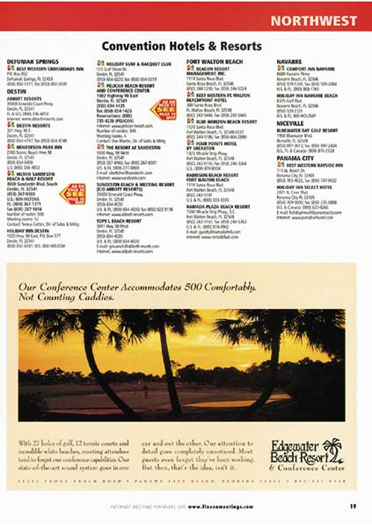
A business-to-business advertisement based on the product usage segmentation strategy.
Notes:
Resorts often segment businesses based on product usage. This ad for Edgewater targets large businesses for conventions and conferences.

Slide 28
Product Positioning
Is the perception created in the consumer’s mind regarding the nature of the company and its products relative to the competition?
Positioning is created by factors such as product quality, prices, distribution, image, and marketing communications.
Notes:
Product positioning is the perception in consumers’ minds of the nature of a company and its products relative to competitors. It is important to recognize the two major points – in consumers’ minds and relative to the competition. Positioning is created by factors such as product quality, prices, distribution, image, and marketing communications. Companies need to carefully consider where they are positioned in the market place then develop ads to reinforce that image or to move consumers to the image that is desired.

Slide 29
F I G U R E 4 . 6
Product Positioning Approaches
Product Attributes
Competitors
Use or application
Price/quality
Product user
Product class
Cultural symbol
Notes:
Effective positioning can be accomplished in seven different ways. Positioning by product attributes involves promoting a unique attribute that is superior or different from the competition. Using competitors to establish a position can be accomplished by contrasting the company’s brand against competing brands. Use or application involves creating a memorable set of uses for a product, or applications that allow it to stand out. Price/quality positioning can occur in two ways – by emphasizing value (low price) or by emphasizing high quality, with little mention of the higher price. The product user approach emphasizes who uses the product, such as educators for Apple computers. Positioning can be based on the product class, such as beverages, breakfast foods, or sports cars. The last approach is cultural symbol, which strives to connect the brand to some cultural symbol that is recognized and known by consumers.

Slide 30
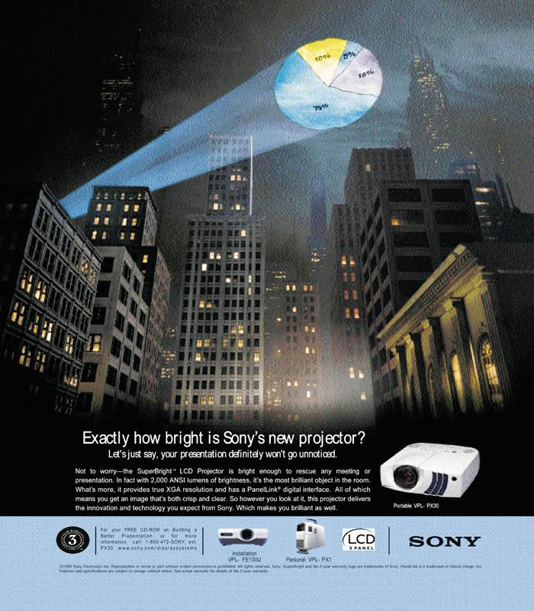
A business-to-business advertisement positioned by the product’s attributes: the brightness of the Sony projector.
An advertisement by Stetson positioned by cultural symbols.
Notes:
The ad by Sony seeks to position the product based on an attribute – the brightness of the projector light. The advertisement by Stetson is using the American cultural symbol of the cowboy to position its product.

Slide 31
Elements of Positioning
Never completely fixed
Applies to business-to-business also
International positioning important
Critical component of image and brand management
Notes:
Product positioning is never fixed, because consumers and society change. The same holds true for business products. In the international arena, product positioning is very challenging, but important. The position that is used in one country, however, may not be appropriate for another country. Product positioning is a critical component of image and brand management because it is how consumers (or businesses) view the brand compared to competing brands.

Slide 32
Marketing
Communications Objectives
Target
Markets
Organization
Context
Positioning
Communications
Objectives
Budget
IMC Components
Notes:
An effective IMC planning process requires quality communications objectives. These objectives tie the organization’s context, target markets, and positioning approaches to the selection of budget figures and IMC components. Communication objectives also guide account executives and advertising creatives in designing the actual advertising campaign.

Slide 33
F I G U R E 4 . 7
Communication Objectives
Develop brand awareness
Increase category demand
Change customer beliefs and attitudes
Enhance purchase actions
Encourage repeat purchases
Build customer traffic
Enhance firm image
Increase market share
Increase sales
Reinforce purchase decisions
Notes:
This is a list of common communication objectives. Most IMC campaigns will emphasize one communication objective, but may accomplish other objectives in the process. There are some logical combinations, such as developing brand awareness and building customer traffic. Increase market share would fit with increase sales and encourage repeat purchase actions. The key is to match the objective to the medium and the message.

Slide 34
Marketing
Communications Budget
Budgets based on
communication objectives
marketing objectives
Budgets vary from consumer to B-to-B markets
Unrealistic assumption to assume direct relationship between advertising and sales
Notes:
The final two steps in the IMC planning process is establishing the communications budget and selecting the IMC components. Both decisions are usually made simultaneously. The marketing communications budget is based on the communication objectives and the marketing objectives. Budgets vary considerably from consumer markets to business-to-business markets. It is unrealistic to expect a direct relationship between budgets and sales. For example, increasing an advertising budget by 25% will not automatically increase sales by 25%.

Slide 35
Factors Impacting Relationship Between Promotions and Sales
The goal of the promotion
Threshold effects
Diminishing returns
Carryover effects
Wear-out effects
Decay effects
Random events
Notes:
A number of factors influence the relationship between promotions and sales. The goal of the promotion may be to increase brand awareness or build brand image. If so, there will be less impact on sales than with some of the other objectives. Threshold effects are present at the point where the advertising or communications begins to affect consumer responses in a positive direction. Carryover effects refer to an ads message being remembered or carried over to the time when the product is needed and the consumer is thinking about the purchase. Wear-out effects happen when an ad or message becomes old and stale and the consumer no longer pays attention to it. Decay effects occur when a company quits advertising and the brand name begins to fade in people’s memories. Sales can also be impacted by just random events, such as a major snow storm.

Slide 36
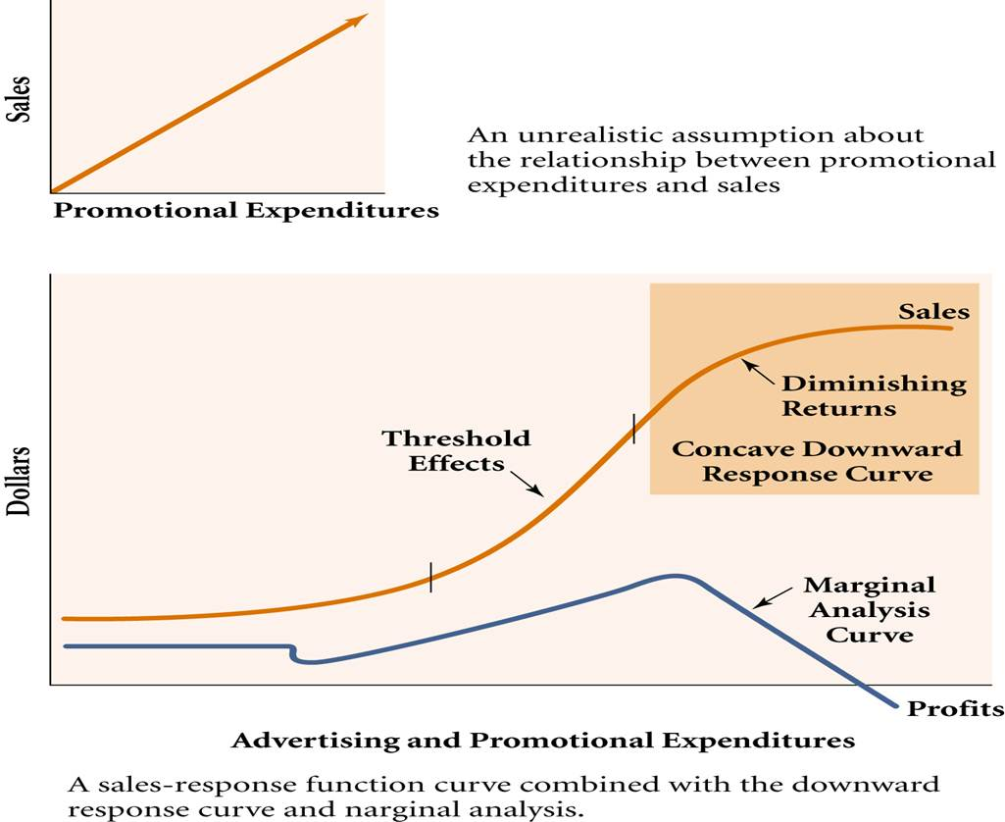
F I G U R E 4. 8
A Sale-Response Function Curve Combined with the Downward Response Curve and Marginal Analysis
Notes:
The straight line is an unrealistic assumption about the relationship between expenditures and sales. The bottom curve is more indicative of what happens. Advertising dollars are spent and for awhile nothing happens. Then consumers begin to pay attention and start purchasing the product, the threshold effect. As more advertising dollars are spent, diminishing returns occur. With each additional dollar in advertising, the impact is less and less. This is the concave downward response curve.

Slide 37
Carryover effects are important in advertising products such as boats.
Notes:
This ad by Yamaha relies on carryover effects of advertising. Boats are not purchased everyday so the hope of Yamaha is that when a consumer starts thinking about boats, he/she will remember the Yamaha brand and this ad.

Slide 38
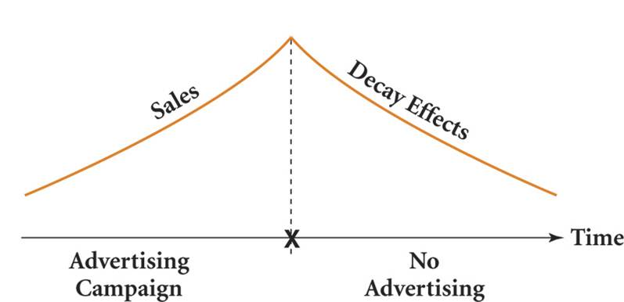
F I G U R E 4 . 9
A Decay Effects Model
Notes:
This curve illustrates decay effect. During the advertising campaign, sales often continues to climb. Then the campaign ends and consumers begin to forget the brand name, it starts decaying.

Slide 39
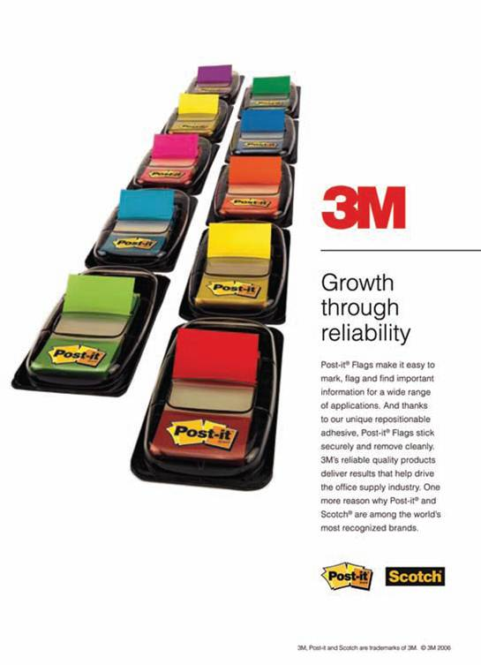
F I G U R E 4 . 10
Methods of Determining Marketing Communication Budgets
Percentage of sales
Meet-the-competition
“What we can afford”
Objective and task
Payout planning
Quantitative models
Notes:
Companies have a number of ways of determining a communications budget. Setting budgets for large companies with multiple brands and products is often more challenging than with a small company that may sell only one brand of a few products.

Slide 40
Types of Budgets
Percentage of Sales
Sales of current year, or next year
Simple
Tends to work in the opposite direction
Does not meet special needs
Meet the competition
Seeks to prevent market share loss
Highly competitive markets
Dollars may not be spent efficiently
Notes:
The percentage of sales sets the communication budget as a certain percent of this year’s sales or next year’s sales forecast. It is simple to use and as a result popular. The problem is that it works in the opposite direction of what may be needed. When sales increase, so does the budget. When sale decline, the budget is reduced. It should be just the reverse. It also does not allow for special needs that may rise. Meet-the-competition sets a budget approximately equal to competitors. This approach is used in highly competitive markets where you have to spend what the competition does to keep your brand in front of consumers. Spending the same as competitors does not guarantee success.

Slide 41
F I G U R E 4 . 11
Ad Spending, Brand Recognition, and Market Share
Auto Insurer | Ad Spending (millions) | Brand Recognition | Market Share
Geico | $600 | 98% | 8.2%
Progressive | $506 | 92% | 7.5%
State Farm | $455 | 76% | 18.6%
Allstate | $369 | 63% | 10.5%
Farmers | $203 | 59% | 6.4%
Source: Adapted from Gregory Bresiger, “It’s Ad Infinitum,” New York Post, May 1, 2011, www.nypost.com/f/print/news/business/it_ad_infinitum_3ThF9rxodhlKnSkcIjdTPK.
Notes:
In terms of total marketing expenditures, approximately 41.1% is spent on some form of advertising. Consumer promotions account for 27.9% and trade promotions for 27.5%. These percentages will vary from industry to industry. It will also be different for products and services, and for consumer companies and B-to-B firms.

Slide 42
Types of Budgets
What we can afford
Set after all other items budgeted
Not understand importance of marketing
Objective and task
Budgets determined by objectives
Best method of budgeting
Used by 50% of firms
Notes:
“What we can afford” approach sets the communications budget after all of the other budges are set. Normally, with this approach, management does not see the importance of communications. Objective and task sets the budge based on what it will cost to accomplish communication and the marketing objective that has been established. Most marketers see this as the best method of budgeting. It is now being used by about half of all firms.

Slide 43
Types of Budgets
Payout planning
Ratio—advertising to sales or market share
Larger percent at product launch
Lower percent when brand established
Based on threshold effect
Quantitative models
Computer simulations
Develop models based on historical data
Notes:
Payout planning involves setting a budget based on a ratio to sales or market share. This method usually results in more money being spent early in the process and then reducing the budget after the brand is established. Quantitative models use historical data to determine the relationship between sales and marketing, then sets the budget accordingly.

Slide 44
IMC Components
Traditional advertising
Trade promotions
Consumer promotions
Media spending
Alternative media spending
Business-to-business media spending
Notes:
The last decision (in conjunction with the budget) is the selection of IMC components. Traditional advertising cannot be ignored in favor of newer, nontraditional methods. Companies have to think about how much is needed for trade promotions and consumer promotions. Then there is the actual spending on media. Some companies will also have to consider business-to-business spending. It is not an easy task to decide on which components will be the most effective. Not only is the budget a factor, but also the objectives.

Slide 45
F I G U R E 4 . 12
Breakdown of Marketing Expenditures
Notes:
In terms of total marketing expenditures, approximately 41.1% is spent on some form of advertising. Consumer promotions account for 27.9% and trade promotions for 27.5%. These percentages will vary from industry to industry. It will also be different for products and services, and for consumer companies and B-to-B firms.

Slide 46
F I G U R E 4 . 14
U.S. Alternative Media Spending
Source: Adapted from “U.S. Alternative Media Spending,” 2008 Marketing Fact Book, Marketing News, July 15, 2008, p. 18, 22.
Notes:
When looking at alternative media spending, the largest category is for online and mobile, 40%. The second largest expenditure is for branded entertainment, 30%.

Slide 47
F I G U R E 4 . 15
U.S. B-to-B Direct Marketing Spending
Source: Adapted from B-to-B Marketing in 2009: Trends in Strategies and Spending, Marketing Profs Research, Inc.,, p. 18.
Notes:
The business-to-business market, telephone marketing is first with 32.2%. Direct mail is second at 15.8% and Internet marketing is third with 14.5%.

Slide 48
F I G U R E 4 . 1 6
Successful Globally Integrated Marketing Communications Tactics
Understand the international market
A borderless marketing plan
Thinking globally but acting locally
Local partnerships
Communication segmentation strategies
Market communication analysis
Solid communication objectives
Notes:
Successful global integrated marketing communications require paying attention to a number of factors. The company must understand the international market and cultures where it will be selling products. A borderless marketing plan works best, but in developing this type of plan, firms must allow individual countries to modify the marketing plan. The idea is to think globally, but act locally. Seeking local partnerships can be very advantageous, especially in developing communication segmentation strategies and conducting a market communication analysis. With this information, solid communication objectives can be established.

Slide 49
Ouachita Independent Bank (Part 4)
ClowBaack – Integrated Campaigns in Action
Segmentation
VALS2 – Thinkers, Achievers, Believers
Notes:
The segmentation approach used for Ouachita Independent Bank was to focus on the VALS2 groups – thinkers, achievers, and believers. These individuals are conservative and tend to value the importance of supporting the local community. They are also tend to value personal relationships with people and feel secure in knowing the people at the bank.

Slide 50
Ouachita Independent Bank (Part 4)
ClowBaack – Integrated Campaigns in Action
Positioning
Product class →Local Bank
Theme of campaign - Local people, local trust
Notes:
The campaign theme is local people, local trust. This demonstrates a positioning approach by product class, local banks. It does not want to be in the class of large, national banks.

Slide 51
Ouachita Independent Bank (Part 4)
ClowBaack – Integrated Campaigns in Action
Communication Objective
Build brand preference.
Notes:
The communication objective for the campaign is to build brand preference where Ouachita Independent Bank is preferred over other banks, especially larger, national and regional banks.

Slide 52
Integrated Campaigns in Action
Skyjacker
Notes:
Skyjacker was developed in 1974 in West Monroe, Louisiana and is one of the largest manufacturers of suspension lift kits and shocks for four-wheel vehicles, SUVs, and trucks. Skyjacker utilizes an in-house marketing department headed by Lee McGuire. The company produces all of its own advertising and marketing materials. This PowerPoint presentation presents an overall of the Skyjacker’s marketing program.

