Slide 1
10
Chapter Ten
Alternative Marketing
Notes:
Traditional mass media faces many challenges. Although advertisers are not ready to abandon mass media, they are looking for alternative ways to reach consumers.

Slide 2
Alternative Marketing Programs
Requires creativity and imagination
Identify intersect paths
Alternative media programs
Buzz marketing
Guerilla marketing
Lifestyle marketing
Experiential marketing
Product placement
Branded entertainment
The goal is to reach consumers in unexpected ways or in everyday life situations that resonate with consumers and where there is less competition for attention.
Notes:
Developing alternative marketing programs require creativity and imagination. Marketers look for new places where a consumer’s path intersects with a brand’s presence. The goal is to reach consumers in unexpected ways or in everyday life situations that resonate with consumers and where there is less competition for attention.

Slide 3
Buzz Marketing
Word-of-mouth marketing
Higher credibility
Fast growth – now $1 billion annually
Methods of generating buzz
Consumers who like a brand
Sponsored consumers
Company or agency generated buzz
Notes:
Buzz marketing has become one of the fastest growing areas in alternative marketing. Estimated expenditures for buzz marketing are now at $1 billion annually. Buzz marketing emphasizes consumers passing along information about a product and since it is word-of-mouth from an individual, it has a higher level of credibility. Methods of generating buzz are through consumers who use and truly like a brand, consumers who are sponsored to talk about a brand, and a company or agency generating buzz.

Slide 4
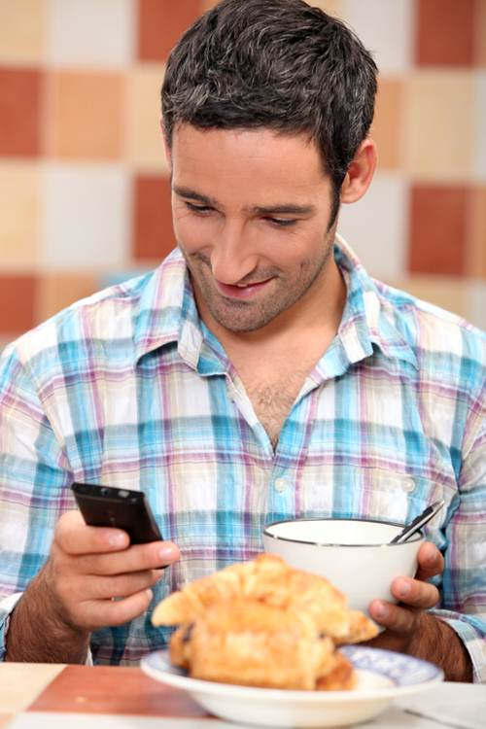
Consumers Who Like a Brand
Ideal ambassador
Buzz spread
In person
Internet
Chat rooms
Blogs
E-mails
Notes:
A consumer who likes a brand and uses it is the ideal brand ambassador. They can spread buzz through personal conversations with people and also online through chat rooms, blogs, and e-mails. While these are the ideal ambassadors, companies have no control of what they say or who they talk to.

Slide 5
Sponsored Consumers
Agent or advocate for a new brand
Brand ambassadors or customer evangelists
Typically individuals who already like brand
Offer incentives in exchange for advocacy
Selection based on
Devotion to brand
Size of social circles
Expected to delivery messages
Grassroots efforts
Low-cost marketing events
Online social networks
Honest about relationship
Notes:
Many companies sponsor individuals as agents or advocates to introduce new products. It works best when the person likes the brand and uses it. Companies normally offer some type of incentive in exchange for the positive advocacy. It can be cash, but most of the time is merchandise. Selection of brand ambassadors is based on a person’s devotion to a brand and the size of their social circle. Since the idea is to talk to their friends and other people, the size of the social influence is important. They are expected to design their own grassroots effort on how they will promote the brand. Many will use low-cost marketing events and even online social networks. Although the individual is being sponsored, the key for success is that they are genuine and do believe in the product being pitched.

Slide 6
Company Employees
Employees posing as customers
High risk approach
Word of Mouth Marketing Association (WOMMA)
Honesty of relationship
Honesty of opinion
Honesty of identity
Notes:
The last approach to buzz marketing is using company or agency employees. It is a high risk strategy, especially if the person doesn’t identify himself as an employee and the public finds out. The Word of Mouth Marketing Association (WOMMA) suggests three principles to follow for any type of buzz marketing campaign. 1) Be honest about the relationship you have with the company and what you get for being a sponsor. 2) Be honest with your opinion. Don’t say just what the sponsor company wants you to day. 3) Be honest about your identity.

Slide 7
Buzz Marketing Stages
Incubation
Infection
Inoculation
Buzz marketing difficult during inoculation stage
Must use brand ambassadors or customer evangelists
True customer-generated buzz occurs after awareness
Awareness generated through traditional advertising
Notes:
Buzz marketing can be compared the stages of a virus: inoculation, incubation, and infection. Inoculation is when the product is being introduced. It is difficult to generate buzz marketing during this stage. Incubation is when the product is being tried by a few innovators and trendsetters. Buzz marketing is easier, but still difficult. Infection is when widespread use of the product begins. The best time for a buzz marketing program. True customer-generated buzz occurs after awareness and often the awareness is generated through traditional media.

Slide 8
Buzz Marketing Preconditions
Brand must be unique, new, or perform better
Brand must stand out
Advertising should be
Memorable
Intriguing (Interesting)
Different
Unique
Customers must get involved
Buzz marketing works because
People trust someone else’s opinion
People like to give their opinion
Notes:
Buzz marketing works the best when the brand is unique, new or performs better than the competition. The brand should stand out in some way. Its advertising should be memorable, intriguing, different, or unique. If a company can get customers involved, it works best. Buzz marketing works because people trust someone else’s opinion and people like to give their opinion.

Slide 9
Guerilla Marketing
Developed by Jay Conrad Levinson
Instant results with unique, low-cost approaches
Focus on region or area
Involve interacting with consumers
Create excitement
Goal is to generate buzz
Grassroots efforts
Alternative media
Notes:
Guerilla marketing was developed by Jay Conrad Levinson. It is designed to bring instant results with low-cost, unique marketing methods. Guerilla marketing focuses on a region or area and involves interacting with consumers in a unique and different way. The goal is to create excitement and to generate buzz. It is often connected with grassroots efforts to launch a brand or to market a product. Often alternative media are used. Pink Jacket Creative used guerilla marketing to launch the caffeine chip, Engobi, which is described in the Integrated Campaigns in Action feature.

Slide 10
F I G U R E 10 . 5
Reasons for Using Guerilla Marketing
To find new ways to communicate with customers
To interact with customers
To make advertising accessible to consumers
To impact a spot market
To create buzz
To build relationships with consumers
Source: Adapted from Lin Zuo and Shari Veil, “Guerilla Marketing and the Aqua Teen Hunger Force Fiasco,” Public Relations Quarterly, Vol. 51, No. 4 (Winter 2006/.2007), pp. 8-11
Notes:
Marketers have a number of reasons for using guerilla marketing. Companies are looking for new ways to communicate and interact with customers that bypass the traditional methods. Guerilla marketing can make advertising more accessible to consumers. It can impact a spot market and create buzz that can quickly spread beyond where it is occurring. Guerilla marketing can be used to build relationships with customers.

Slide 11
Lifestyle Marketing
Associated with hobbies and entertainment
Contacting consumers where they go for
Relaxation
Excitement
Socialization
Enjoyment
Notes:
Lifestyle marketing involves identifying marketing methods associated with the hobbies, entertainment, and lives of the target audience. It involves making contact with consumers were they go for relaxations, excitement, socialization, and enjoyment. The idea is to intersect with consumers during their daily lives. For instance, A/X Armani Exchange reaches young consumers through sponsoring and setting up booths at music festivals and fashion shows.

Slide 12
Experiential Marketing
Direct marketing + Field Marketing + Sales Promotions
Direct marketing through interactive connection
Engage consumers
Steps to create positive experience
Clear, concise target segment
Identify right time, right place
Engage emotionally
Engage logically
Clearly reveal brand’s promise
Notes:
Experiential marketing is the intersection of direct marketing, field marketing, and sales promotions. Its basic premise is increasing the experience of direct marketing through an interactive connection. Rather than just pass out samples, make it an experience the consumer will remember. Nickelodeon used experiential marketing with their Slime Across American Tour. 30,000 kids were exposed to the exhibit and 20 million television impressions resulted. Jack Morton Worldwide used a traveling mall exhibit to expose consumers to the benefits of cotton and cotton clothing. Consumers could sing and record their own version of the song “Fabrics of Our Lives.”

Slide 13
Product Placement and Branded Entertainment
“Getting products noticed has become increasingly difficult, so companies have shifted more dollars to product placements and branded entertainment.”
Media Perspective
Product Placement
Branded Entertainment
Generate
Revenue
Notes:
Product placement and branded entertainment is an alternative marketing method designed to make an impression on people without it looking like advertising.

Slide 14
Product Placement
Planned insertion
Product placements
Increased awareness
More positive attitude toward brand
No immediate impact on sales
Low cost per viewer
Movies Pay-per-view television
DVD movie rental Television
BRANDED ENTERTAINMENT
Brand woven into the storyline
Use increased sharply with reality shows
Also found in novels, plays, songs, and movies
Notes:
Product placement is a planned insertion in a movie, television show, book or other forms of entertainment. It has been used since the 1890s, but only recently has grown in popularity. The biggest surge in product placement came in 1982 with E. T. and Reese’s Pieces. The placement of the Reese’s Pieces in the movie spurred a 65% increase in sales following the movie’s release. Research has found that product placement increases awareness of the brand, creates a more positive attitude towards the brand, but does not have any immediate impact on sales. From a cost standpoint, product placement has a low cost per viewer of impressions. A primary advantage is that the impressions do not stop with the movie. After the movie has played in theaters it goes to DVD movie rentals, to pay-per-view television, then to the movie channels on television.

Slide 15
F I G U R E 10 . 7
Key Factors in Product Placement and Branded Entertainment
Media
Supporting promotional activities
Consumer attitudes toward placements
Placement characteristics
Regulations
Source: Adapted from Simon Hudson and David Hudson, “Branded Entertainment: A New Advertising Technique or Product Placement in Disguise?” Journal of Marketing Management, Vol. 22, No. 5/6 (July 2006), pp. 489-504.
Notes:
For successful product placement and branded entertainment, choosing the right media is important. It helps when other promotional materials are produced that reinforce or remind individuals of the brand and even the placement. Product placement and branded entertainment work because there is no call to action, so consumers tend to have a positive attitude towards the brand. Some consumers are more receptive than others. People ages 15 to 34 are more likely to notice product placements and be more receptive to them. Sometimes product placements allow companies to bypass regulations and get their products in front of their intended audience.

Slide 16
Company Tactics
Product Placement – Branded Entertainment
Reasons for increased spending:
Appeal stronger in non-advertising context
Perception of what others think is important
Provides post-purchase reassurance
Reach individuals who place little value on brands
Notes:
Budgets for product placement and branded entertainment have been increasing for several reasons. 1) The appeal is stronger for a brand in a non-advertising context. 2) Perceptions of what others think is important, so if a favorite actor or actress is seen using the brand, then it supports the consumer using it. 3) It provides post-purchase reassurance that a good decision was made. 4) It can reach individuals who place little value on brands. If someone they admire uses a particular brand, then maybe he/she should consider purchasing it.

Slide 17
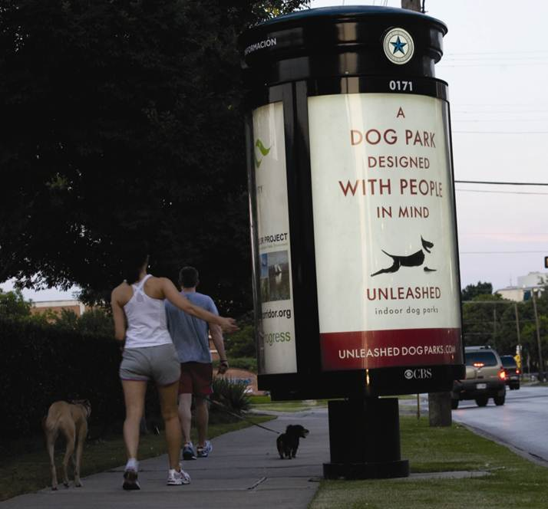
F I G U R E 10 . 8
Alternative Media Venues
Video games
Cinemas
Subways
Street and mall kiosks
Escalators
Parking lots
Airlines
Shopping bags
Clothes
Notes:
Another approach to reaching consumers and breaking through ad clutter is to use some type of alternative media. This list contains some of the options advertisers have.

Slide 18
In-Store Marketing Tactics
In-store “make or break” time
Engage customers
Most engaging
End-aisle displays
Merchandise displays
Lease engaging
Ceiling banners
Overhead mobiles
Use color, light, sound, taste, and smell
Motion
Video screens
Television monitors
Digital signage
Notes:
The in-store shopping experience has a major impact on purchase decisions. It is the “make or break” time in terms of a decision to purchase a particular brand. In-store advertising seeks to engage customers. The most engaging forms of advertising are end-aisle displays and merchandise displays. The least engaging are ceiling banners and overhead mobiles. Using color, light, sound, taste, and smell increases engagement. Motion also engages customers. The motion can be video screens, television monitors, or even digital signage.

Slide 19
Point-of-Purchase Tactics
Location is key
Last chance to reach buyer
Effective for increasing sales because
60% of decisions are in store
50% of money spent at mass-merchandisers and supermarkets is unplanned
50% of Coca-Cola products from displays
Average increase in sales is 9%
Half of POP displays not effective
Half that are effective – 20% increase in sales
Notes:
For point-of-purchase displays location is the key. It is the last chance to reach a potential buyer. POP displays have proven to be effective for increasing sales because most decisions are made in the store. The average increase in sales for a POP is 9%. Only about half of the displays actually impact sales, but for those half the boost is around 20%. Currently, manufacturers spend about $17 billion a year on POP displays.

Slide 20
Brand Communities
Ultimate demonstration of
Brand loyalty
Brand devotion
Symbolic meaning
Interactions between brand and consumer
Shared values and experiences
Cannot be created by brands itself
Marketing can enhance community experience
Notes:
Brand communities are the ultimate in brand loyalty and brand devotion. Jeep, Apple, and Harley Davidson are three brands that have developed strong brand communities. People join a brand community for several reasons. It offers symbolic meaning and provides for interaction between the brand, consumers, and companies that participate. People join because they have shared values and experiences. Brand communities cannot be created by brands or companies. It has to be customer driven. But, brands can enhance the community and provide a richer brand community experience.

Slide 21
F I G U R E 10 . 12
Reasons Brand Communities Form
Affirmation of the buying decision
Social identity and bond
Swap stories
Swap advice and provide help to others
Feedback and new ideas
Notes:
People join a brand community as an affirmation of their buying decision. It provides social identity and bond with fellow brand owners. They can swap stores, swap advice and provide help to each other and to new members. It provides a venue for feedback and new ideas.

Slide 22
F I G U R E 10 . 13
Ways to Enhance a Brand Community
Create benefits to encourage new customers to join.
Provide materials not available anywhere else.
Involve firm representatives in the groups.
Sponsor special events and regular meetings.
Promote communications among members.
Build a strong brand reputation.
Source: Adapted from “Brand Communities,” Bulletpoint, No. 133 (July 2006), pp. 12-16.
Notes:
Companies can enhance a brand community. Companies can create benefits for individuals to encourage them to participate and join in the brand community. Materials and items not available to the public can be provided to members. Representatives from the firm can become involved and sponsor events and meetings. They can encourage and provide an avenue for members to communicate with each other. It is also important for the company to continue its strong brand name and maintain its reputation. Skyjacker is an active participant with Camp Jeep. It benefits the brand community and provides excellent exposure for the company.

Slide 23
12
Chapter Twelve
Sales Promotions
Notes:
This chapter focuses on sales promotions – which include both consumer promotions and trade promotions.

Slide 24
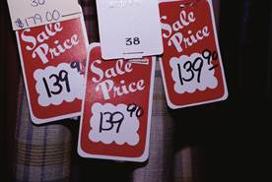
F I G U R E 12 . 1
Types of Consumer Promotions
Coupons
Premiums
Contests and sweepstakes
Refunds and rebates
Sampling
Bonus packs
Price-offs
Notes:
Enticing a consumer to take the final step and make the purchase constitutes a primary goal for consumer promotions. Advertising often creates the interest and excitement that brings consumers to the store, promotions can then be used to encourage the actual purchase. This slides lists the major forms of consumer promotions.

Slide 25
Coupons
300 billion printed
2.5 billion redeemed (0.85%)
Average value was $1.55
Savings of $3.87 billion
Coupon usage
80% of households use
2/3 willing to switch brands
Notes:
Coupons offer a price reduction to the consumer. It may be a percentage off of the retail price, or absolute amount. 300 billion coupons were printed and 2.5 billion were redeemed, a redemption rate of 0.85%. The average value of coupons was $1.55. That equates to about $3.87 billion in savings. Coupons are used at some level in about 80% of households and 2/3 of consumers say they are willing to switch brands with a coupon.

Slide 26
Coupon Distribution
Manufacturers issue about 80%
Freestanding inserts – 90%
Freestanding and print most popular
Consumer makes conscious effort to clip
Create brand awareness
Encourage purchase next trip to store
Digital coupons growing in popularity
Users more affluent, better educated
Notes:
Manufacturers issue about 80% of all coupons. Most coupons are sent through print media with free standing inserts (FSI) accounting for about 90% of all coupons distributed. The advantage of using FSIs is that consumers must make a conscious effort to clip the coupon. This helps create brand awareness and encourages a purchase on the next trip to the store. Digital (online) coupons are growing in popularity. They are easy to find and print. The users of digital coupons are more affluent and better educated than users of printed coupons. Coupons are also now being sent to cell phones and used on smartphones.

Slide 27
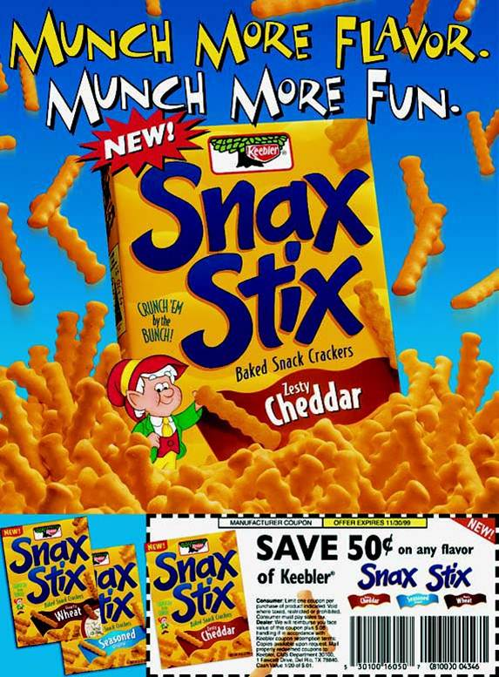
F I G U R E 1 2 . 2
Methods of Distributing Coupons
Print media
FSI
Direct mail
On- or in-package
In-store
Scanner-delivered
Digital
Employee delivered
Notes:
Coupons can be delivered in a variety of ways. Free standing inserts are the most common, with 88% of all coupons being distributed in this way. They can also be distributed through direct mail. They can be placed on packages or inside packages. The can be in the store on shelves, or in bins, or delivered by the scanner at the time of checkout. Coupons can be digital or they can be delivered by employees of an organization.

Slide 28
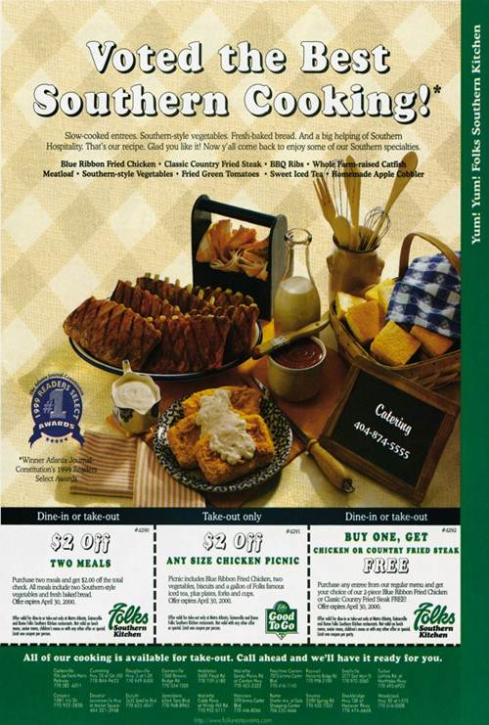
Types of Coupons
Instant redemption
Lead to trial purchases
Bounce-back
Encourages repeat purchases
Scanner-delivered
Encourages brand switching
Cross-ruffing
Notes:
Coupons can be divided into four major types. Instant redemption coupons are typically placed on the outside of a package or attached to a store shelf and can be redeemed immediately. Instant redemption coupons encourage trial purchases since the discount is immediate. Bounce-back coupons are inside a package and encourage repeat purchases because they cannot be used until the package is opened. Scanner-delivered coupons are triggered by an item purchased. The coupon is either for a competing brand or for another variety or flavor than was purchased. The most common motive for scanner delivered is to encourage brand switching on the next trip to the store. Cross-ruffing coupons are placed on one item for another item, such as a coupon for dip placed on a bag of potato chips.

Slide 29
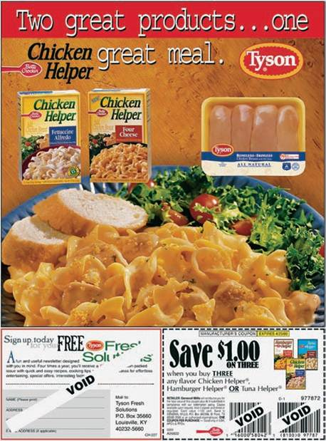
Disadvantages of Coupons
Reduced revenues
80% used by brand preference consumers
Necessary evil
Notes:
The big disadvantage of coupons is reduced revenues. Companies are giving customers a reduction in price, which means they earn less money. Also, 80% of coupons are used by brand preference consumers, which means they likely would have purchased that brand anyway. The coupon just offers it to them cheaper. But, most manufacturers say it is one of those necessary evils to stay in business. Customers expect coupons. Competitors use them so companies have to use them to keep competitors from taking sales away. Retailers expect them so it will pull customers into the store.

Slide 30
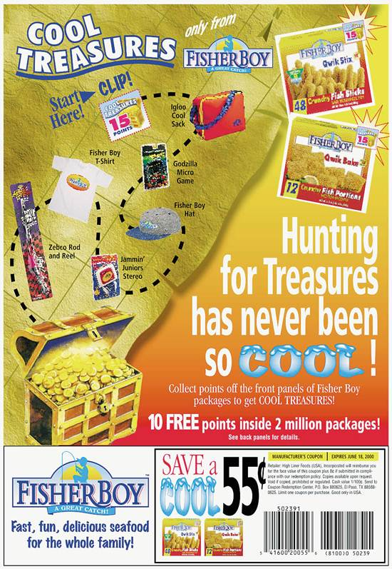
Types of Premiums
Free-in-the-mail
In- or on-package
Store or manufacturer
Self-liquidating
Notes:
Premiums are prizes, gifts, or other special offers consumers receive when purchasing a product. The key to premiums is that consumers pay full price for the product. Four different types of premiums can be used. Free-in-the-mail premiums are free to consumers who mail in X number of box tops or labels. In-or on-package premiums are located in the package or on the package and are received upon purchase. Store or manufacturer’s premiums can vary in how they are delivered. They can be prizes in kid’s meals at a fast food restaurant or a golf bag with the purchase of a new set of clubs. Self-liquidating require a small amount of money with the proof-of-purchase. The amount paid usually covers the cost of the item and may even pay for shipping.

Slide 31
F I G U R E 1 2 . 4
Keys to Successful Premium Programs
Match the premium to the target market
Carefully select the premium
Avoid fads, try for exclusivity
Premium reinforce the firm’s product and image
Integrate the premium with other IMC tools
Especially advertising and POP displays
Don’t expect premiums to increase short-term profits
Notes:
Matching the premium to the target market is important. It needs to be something the target market wants. Try for exclusivity and avoid fads. The premium should reinforce the firm’s products and image, not distract from it. It helps to integrate the premium offer with other IMC tools, such as advertising and POP displays. While premiums can attract customers, don’t expect it to boost short-term profits. In fact, in most cases, companies will loose money on premiums.

Slide 32
Contests and Sweepstakes
Contests
Require activity, skill
Can require purchase to enter
Some states illegal
Sweepstakes – random chance
Must publish odds of winning
Cannot require purchase
Can enter as many times as desired
Notes:
The terms contests and sweepstakes tend to be used interchangeably, but there is a difference. Contests require some type of activity or skill. They can require a purchase to enter, at least in most states. However, for some states it is illegal to require a purchase to enter. Sweepstakes rely on random chance. Laws require the odds of winning each prize to be printed in advance and made available at every location where the sweepstake can be entered. Companies cannot require a purchase to enter, although they can limit people to one entry per visit.

Slide 33
Contests and Sweepstakes
Perceived Value
Consumers selective
Perceived value important
Extrinsic value – attractiveness of prize
Intrinsic value – fun, skill
Small, incremental rewards
Scratch-and-win tickets
Notes:
People enter contests and sweepstake because they find them interesting. A few will enter because of the prizes. Consumers are selective on which ones they enter. They do not enter every contest or sweepstake they see. Extrinsic value is the attractiveness of the prize. The more attractive, the more likely to enter. Intrinsic value is the fun or skill of playing. This is more important in contests than sweepstakes. Small, incremental rewards given sporadically will encourage people to keep participating. Scratch-and-win tickets are popular because people know instantly if they won.

Slide 34
Contests and Sweepstakes
Internet and Social Media
Popular venue
Increase intrinsic value – interactive games
Data-capturing capabilities
Lower costs
Goals
Encourage traffic
Boost sales – questionable
Intrinsic rewards draw consumers back
Notes:
The Internet and social media have become popular venues for sweepstakes and contests. The Internet allows for interactive games, which increases the intrinsic value of playing. Companies can capture data from individuals who play, which can be analyzed and used to plan marketing programs. The Internet is also cheaper.
The goals of contests and sweepstakes should be to encourage traffic to a website or to a retail location. It is doubtful it will boost sales, but it will create awareness and exposure. It is the intrinsic rewards that usually draw people back, not the extrinsic.

Slide 35
Refunds and Rebates
Refunds – soft goods
Rebates – hard goods
Hassle to redeem
Now expected by consumers
Redemption rates
30% overall
65% for rebates over $50
Notes:
The terms refunds and rebates are used interchangeably, but do have different meanings. Refunds are for soft goods, rebates are for hard goods. People do not like refunds and rebates because typically they are a hassle to redeem and they have to wait 6-8 weeks for the check. For some products the rebates have been used for so long, customers expect them and will hardly make a purchase without it. Automobiles and computer printers are two products people now want a rebate to make a purchase. Redemption rates are low, less then 30% overall. But, if the rebate is for more than $50, the redemption rate jumps up to 65%.

Slide 36
Sampling
Delivery of free good or service
Business-to-business to prospects
Service sampling
Consumer survey
33% who tried a sample made purchase during shopping trip
58% would buy product again
25% bought sample instead of intended brand
Notes:
Sampling is the delivery of a free good or service with the hope the person or business will like the brand and purchase it on the next trip or the next time the product is needed. Businesses use sampling extensively to encourage prospects to try the brand and compare it to the brand they are currently using. Services can also provide samples, such as a 7-day free membership at a fitness center or free initial consultation with a lawyer or dentist. According to a consumer survey of people who tried a sample – 33% made a purchase of the brand during that shopping trip, 58% would buy it again, and 25% bought the sample instead of intended brand.

Slide 37
F I G U R E 1 2 . 5
Methods of Distributing Sampling
In-store distribution
Direct sampling
Response sampling
Cross-ruff sampling
Media sampling
Professional sampling
Selective sampling
Notes:
Samples can be distributed in a variety of ways. They can be given to customers as they shop in a store. They can be sent in the mail or delivered as a result of a request. An example of a cross-ruffing sample would be a dryer sheet in a box of detergent or attached to the detergent box. Media samples are distributed through the media, such as the newspapers. Small items, such as perfume, can be attached inside of a magazine to a page. Professional sampling would be a drug company delivering samples to doctors, or vendor supplying samples of raw materials to a manufacturer. Selective sampling normally occurs at special events, such as a rodeo or state fair, where a company may distribute a sample of its drink or candy bar for people to try.

Slide 38
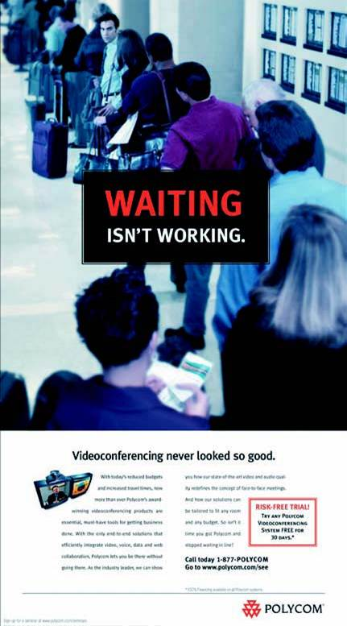
Benefits of Sampling
Introduce new products
Generate interest
Generate leads
Collect information
Internet sampling
Boost sales
Notes:
Sampling is an excellent means of introducing a new product. It can generate interest and leads, especially for B-to-B operations. It can be a way of collecting information, especially for response sampling. Sampling can boost sales through people buying the brand immediately, or on their next trip. Many consumers search the Internet for information and companies can provide an opportunity for them to request a sample at that time.

Slide 39
Successful Sampling Programs
Central part of IMC plan
Encourage trial purchases
Most effective for
New products
New versions of current products
Current products to new markets
Target right audience at right venue
Mass sampling not cost effective
Notes:
Successful sampling programs are a central part of an IMC plan. It is an excellent means of encouraging trial purchases. It is most effective for new products, new versions of products, and current products to new markets. It is important to target the right audience at the right venue to ensure success. Mass sampling is not cost effective. Firms need to target their sampling programs.

Slide 40
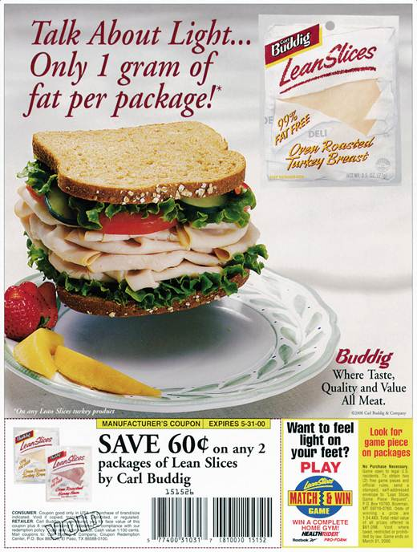
Bonus Packs
Extra product in special package
Typical bonus
20% to100% percent
Most common
30% bonus
Notes:
When an additional or extra number of items are placed in a special package, it is a bonus pack. Typical bonuses range from 20% to 100%, with 30% being the most common.

Slide 41
F I G U R E 1 2 . 6
Bonus Pack Objectives
Increase usage of a product
Match or preempt competition
Stockpile the product
Develop customer loyalty
Attract new users
Encourage brand switching
Notes:
Companies use bonus packs for a variety of reasons. It can be used to increase usage of the product. If consumers have extra potato chips, they are likely to eat more. It can be used to match or preempt the competition. Consumers can stockpile the item so an offer by a competitor is no longer attractive. It can enhance brand loyalty, especially if consumers feel they are getting a good deal with the bonus pack. It can attract new users, but most likely these are individuals who have tried the brand in the past and have a favorable attitude towards the brand. It can also encourage brand switching, but under the same scenario as a new user.

Slide 42
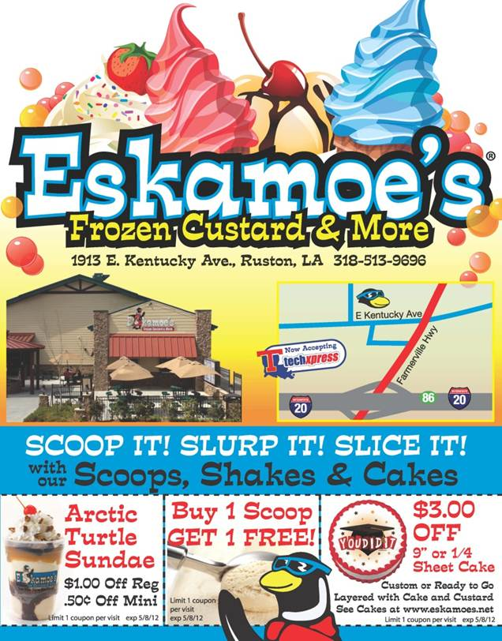
Price-Offs
Temporary price reduction
Notes:
A price-off is a temporary price reduction. It can be marked on the item or its package, or displayed on the shelf or near the item.

Slide 43
Price-Offs
Benefits of price-offs
Excellent for stimulating sales
Entice trial purchases
Lower financial risk
Encourage brand switching
Encourage stockpiling
Problems with price-off
Negative impact on profits
Encourages greater price sensitivity
Potential negative impact on brand image
Notes:
Price-off promotions are the best and quickest method to stimulate sales. A price reduction can also entice consumers to try a product because the financial risk has been reduced. With the lower price, it can encourage brand switching and stockpiling the item. The benefit of customers stockpiling is they may consume more of the product. The major disadvantages is that a price-off will reduce profits. It normally takes a 20% to 40% boost in sales to offset just a 5% price reduction. It encourages greater price sensitivity. Consumers become reluctant to pay full price for the item. Long-term, it can have a negative impact on brand image.

Slide 44
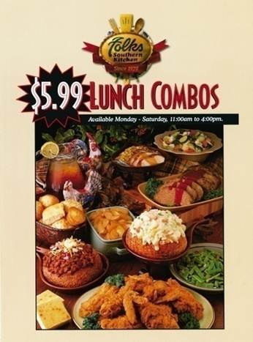
Impact of Price-off on Consumer Purchase
Consumer purchased because of sale price
9%
Consumer unaware item was on sale.
51%
Consumer would have purchased item anyway
40%
Source: “Studies Indicate Coupons are an Effective Promotional Tool,” Santella & Associates (http://www.santella.com/coupon.htm, August 2009)
Notes:
It is interesting to look at the impact a price-off has on a purchase decision. The majority, 51%, was not aware the item was on sale when they purchased. Another 40% would have purchased the product anyway. That means only 9% of consumers purchased the item because of the price-off.

Slide 45
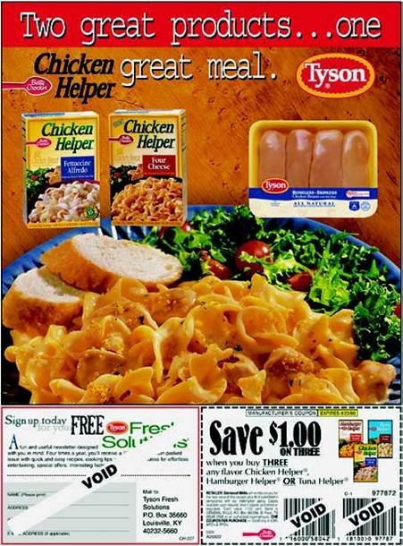
Overlays and Tie-Ins
Overlay
2 or more promotions
Intra-company tie-in
Products within a company
Inter-company tie-in
Partnering with another company
Notes:
At times companies combine two or more consumer promotions into a single campaign, called an overlay. It may involve a promotion for a sweepstake or contest with a coupon attached to encourage purchasing the product. A common overlay is passing out coupons at the same time consumers are given a sample of the product. Tie-ins are when two or more companies or products are promoted within a single campaign. An intra-company tie-in involves products with one company. Inter-company tie-ins involve two or more companies working together, such as is illustrated in this ad with Tyson and Betty Crocker.

Slide 46
Planning Consumer Promotions
Promotion-prone
Brand-loyal
Brand-preferred
Price-sensitive
Notes:
Consumers can be divided into four groups based on their proneness to use promotions. Consumers tend to fall into one of the four groups, but it will also vary by product. Someone who is brand loyal for ketchup may be price-sensitive for coffee. Promotion-prone consumers regularly respond to various consumer promotions and like to purchase products when they are on-deal. Brand-loyal consumers purchase only one particular brand of a product and will not substitute a competing brand regardless of the type of promotion being offered. Brand-preference consumers have a small set of brands for which they have a strong preference. Promotions for one of these select brands will impact which brand is purchased. Price-sensitive consumers purchase whichever brand has the lowest price and use promotions that reduces the price.

Slide 47
Planning Consumer Promotions
Support brand image and position strategy
Consider target audience
Promotion-prone consumers
Respond to deals
Price-sensitive consumers
Price primary factor in purchases
Deals that reduce price
Notes:
In planning consumer promotions, firms must always support the brand image and position strategy and choose promotions that reinforce the image and position that is desired. It is also important to consider the target audience and the types of promotions they are the most receptive to. In terms of types of consumers, the promotion-prone consumers respond to deals and will switch to a brand being offered on-deal. That means a competitor can offer a deal and they will immediately switch. Price-sensitive consumers don’t care about the brand name. They just want the cheapest product. While promotions will boost sales from these two groups, neither group is loyal and as a result not attractive in the long run.

Slide 48
Planning Consumer Promotions
Brand-loyal consumers
Purchase only preferred brand
Brand-preference consumers
Small set of preferred brands
Deals for one of preferred brands
Varies by product
Tendency towards one type
Brand-preference consumers best target
Notes:
Brand loyal consumers will stay with your brand and don’t need a promotion to make a purchase. If they are brand loyal to a competing brand, a promotion is not going to sway them to make a purchase. The best group to pursue is brand-preference consumers. They have a small set of brands they prefer and deals for one of those brands can modify purchase behavior. They also can be encouraged to become more brand loyal. While consumers tend to be one of the four types, it also varies across product categories. Of the four groups, the brand-preference consumers are the best target.

