Slide 1
7
Chapter Seven
Advertising Design
Message Strategies and
Executional Frameworks
Notes:
Chapter 7 addresses the second part of advertising design – message strategies and executional frameworks.

Slide 2
Dove’s Campaign for Real Beauty
7
2007 – “Onslaught”
Social pressures of young girls
Does not mention Dove in ad
Age compression marketing
Body image issues
“Campaign for Real Beauty”
Unilever Axe – sexually-oriented advertising
Notes:
Advertising and marketing to women and girls may be at a crossroads. Clearly, pressures to grow up more quickly and look older at a younger age is occurring. Recently Dove created an ad called “Onslaught” that conveyed the social pressure young girls face. Dove is not mentioned anywhere in the ad. Because of fashions, models, and actresses on TV, girls often grow up with body image issues. As a result, Dove created the ad “Campaign for Real Beauty.” The goal of the ads is to convey real feminine beauty. Ironically, the same company, Unilever, that owns Dove owns Axe, which uses strong sexually-oriented advertising – directed to youth.

Slide 3
Chapter Objectives
7
Advertising Design
Message Strategies and Executional Frameworks
How are the three main types of message strategies used to increase advertising effectiveness?
What types of executional frameworks help to deliver quality advertising messages?
What types of sources or spokespersons can be used in advertisements or commercials?
What characteristics are most important when selecting a source or spokesperson?
What process is used to create advertisements?
What are the principles of advertising effectiveness?
How are advertising programs adjusted to fit international circumstances?
Notes:
These are the objectives for Chapter 7.

Slide 4
Chapter Overview
7
Advertising Design
Message Strategies and
Executional Frameworks
Message strategies
Executional frameworks
Spokespersons and endorsers
Principles of effective advertising
Notes:
Chapter 7 continues presenting information about advertising design. This chapter covers message strategies, executional frameworks, spokespersons and endorsers, and then concludes with a discussion of the principles of effective advertising.

Slide 5
Message Strategies
Cognitive
Affective
Conative
Notes:
The message theme outlines the key ideas in an advertisement. It is a central part of the creative brief. The message then can be created using a number of different message strategies, which is the primary tactic or approach used to deliver the message theme. Message strategies can be divided into three main categories that correspond with the three components of attitude – cognitive, affective, and conative.

Slide 6
Message Strategies
Cognitive
Affective
Conative
Generic
Preemptive
Unique Selling Proposition
Hyperbole
Comparative
Notes:
A cognitive message strategy presents rational arguments or pieces of information to consumers. Cognitive message strategies are designed to influence the cognitive component of attitude, which deals with beliefs and knowledge. Cognitive message strategies can be divided into five types – generic, preemptive, unique selling proposition, hyperbole, and comparative.

Slide 7
Generic Cognitive Message Strategy
Notes:
A preemptive cognitive message strategy makes a claim of superiority based on a product’s specific attribute or benefit with the intent of preventing the competition from making the same claim. This advertisement for Waterfront Grill uses a preemptive message strategy. An effective preemptive message strategy can occur when a company is the first to state an advantage or benefit.

Slide 8
Preemptive Cognitive Message Strategy
A television advertisement for the Waterfront Grill created by Sartor Associates using a pre-emptive cognitive message strategy.
Notes:
A preemptive cognitive message strategy makes a claim of superiority based on a product’s specific attribute or benefit with the intent of preventing the competition from making the same claim. This advertisement for Waterfront Grill uses a preemptive message strategy. An effective preemptive message strategy can occur when a company is the first to state an advantage or benefit.

Slide 9
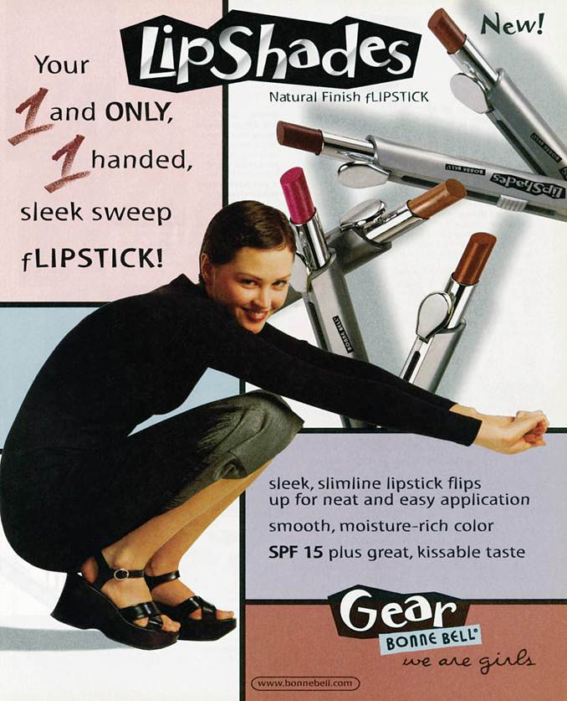
Unique Selling Proposition Cognitive Message Strategy
An advertisement by Bonne Bell using the unique selling proposition.
Notes:
A unique selling proposition message strategy focuses on a testable claim of uniqueness or superiority. This ad for Bonne Bell says that its flipstick is the “1 and only 1 handed sleek sweep flipstick”. Such a claim is testable and as a result Bonne Bell must be able to support this claim.

Slide 10
Hyperbole Advertising Cognitive Message Strategy
Untestable claim
Does not require substantiation
Popular cognitive approach
Notes:
A hyperbole cognitive message strategy is an untestable claim based on some attribute or benefit. It does not require substantiation, which makes it a popular cognitive strategy approach. Notice in the ad says “I found something better” which is a hyperbole statement.

Slide 11
Comparative Advertising Cognitive Message Strategy
Direct or indirect comparisons
Real or fictitious competitor
Advantage – captures attention
Brand awareness increases
Message awareness increases
Negative – less believable, negative attitude
Negative comparative ad
Spontaneous trait transference
Choose comparisons carefully
Notes:
A comparative cognitive message strategy focuses on a direct or indirect comparison to a competing brand. The brand can be real, mentioned, or fictitious. The advantage of comparative ads is that they tend to capture attention. Brand awareness and message awareness tend to be higher. The negative is that they can be less believable and can create a negative attitude. This is most likely to occur when a negative comparison approach is used in the ad, downgrading the competing brand. If the consumer does not believe the ad, then spontaneous trait transference can occur, which is placing the negative trait on the advertised brand instead of the competitor. It is important to choose competitors wisely in making comparisons.

Slide 12
Message Strategies
Cognitive
Affective
Conative
Resonance
Emotional
Notes:
Advertisements that invoke feelings or emotions are affective message strategies. These messages attempt to enhance the likeability of a product, recall of the message, and comprehension of the message. The two types of affective message strategies are resonance and emotional. Resonance advertising connects a product with a consumer’s experiences from the past in order to develop a bond with the brand. Often, advertisers will use music from that generation to create that emotional bond. Emotional messages attempt to elicit emotions that will lead to product recall and choice. Many different emotions can be connected with a product. Emotional messages are used in both consumer and business-to-business advertising. Affective message strategies help develop brand equity through creating an emotional bond with the brand.

Slide 13
Affective Message Strategy
Invoke feelings or emotions
Attempts to enhance likeability
Resonance Advertising
Connects with consumer experiences
Comfort marketing
Emotional Advertising
Emotions lead to recall and choice
Consumer and b-to-b markets
Leads to positive feelings
Notes:
Affective message strategies invoke feelings or emotions with the goal of enhancing likeability, recall, and comprehension. Affective strategies can be resonance or emotional. Resonance advertising connects a brand with a consumer’s experience. A new form of resonance advertising is comfort advertising, which encourages consumers to purchase a brand rather than generic products because brands have stood the test of time, and consumers can take comfort in them. Emotional advertising elicits powerful emotions that lead to recall and choice. Used in both consumer and b-to-b markets. Emotional advertising can lead to more positive feelings about a brand.

Slide 14
Advertisement by Cheerios using a resonance, affective message strategy.
Notes:
This ad for Cheerios is an example of resonance advertising. It shows the emotion of a 3-generation family.

Slide 15
Message Strategies
Cognitive
Affective
Conative
Action-inducing
Promotional support
Notes:
Conative message strategies are designed to lead directly to some type of action or response. Action-inducing conative ads encourage consumers (or businesses) to act in some way, to do something. It can be to make an inquiry or access a Web site for more information. Promotional support conative messages are tied with some type of promotion. It may be a coupon, a contest, or a sweepstake.

Slide 16
An advertisement for Cub Cadet encouraging immediate action!
Notes:
This ad for Cub Cadet uses a conative message strategy because it encourages consumers to make an immediate purchase.

Slide 17
F I G U R E 7 . 2
The Hierarchy of Effects Model and Message Strategies
Cognitive
Strategies
Awareness
Knowledge
Affective
Strategies
Liking
Preference
Conviction
Conative
Strategies
Purchase
Notes:
Because message strategies correspond to the components of attitude, they can be matched with the different stages of the hierarchy of effects model. Cognitive strategies deal with awareness and knowledge. Affective strategies deal with emotions and the stages of liking, preference, and conviction. Conative strategies encourage action and match the purchase phase of the model.

Slide 18
Executional Frameworks
F I G U R E 7. 3
Animation
Slice-of-life
Testimonial
Authoritative
Demonstration
Fantasy
Informative
Notes:
An executional framework signifies the manner in which an advertising appeal will be presented. It should be chosen in conjunction with an advertising appeal and a message strategy. There are 7 different executions that can be used. While almost any execution can be used with any appeal and message strategy, there are logical combinations and there are some combinations that do not work well together. For instance, a common combination would be emotional appeal, affective message strategy, and slice-of-life execution. A combination that would be difficult to pull off would be rational appeal, affective message strategy, and demonstration execution.

Slide 19
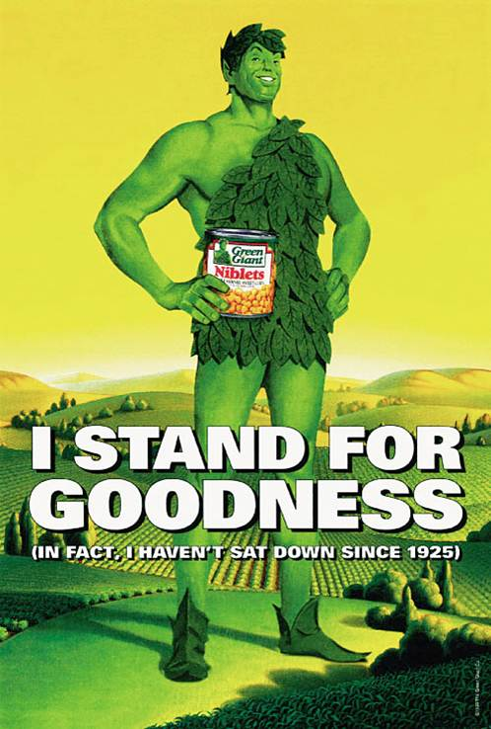
Animation
Originally – cheap method
Usage has increased
Enhanced graphics technology
Rotoscoping
Costs coming down
Business-to-business use
Notes:
Animation was originally a cheap way to advertise. Companies that could not afford actors, used animation. Its usage has increased and is often now a chosen method of advertising. The skill and quality of animation has improved greatly in the last 20 years. One technique, known as rotoscoping, involves drawing animated characters into scenes with live characters. It also can be used to merge live video scenes to make it look like it really happened or all occurred at the same time. The costs of animation have come down in recent years which makes it more appealing to advertisers. It is now used even for B-to-B advertising.

Slide 20
Components of a Slice-of-Life Ad
F I G U R E 7. 4
Solution
Interaction
Problem
Encounter
Notes:
The slice-of-life execution was made popular by Procter & Gamble in the 1950s. The basic premise is the introduction of a problem that a product solves. Slice-of-life has four distinct stages. It opens with an encounter between people or with a situation. A problem occurs. Then there is interaction, which can be a voice-over or conversations between two people. Then comes the P & G product that solves the problem. The typical detergent scenario is of a child’s uniform getting dirty and now it is not available for the championship game. The mother interacts with a neighbor who recommends Tide or Cheer and the uniform is clean. All are happy as the child runs out onto the field in a clean uniform.

Slide 21
Slice-of-life
A business-to-business print advertisement using a slice-of-life executional framework.
The text asks:
“If the average single female breaks up with 4.3 men, avoids 237 phone calls and ignores 79 red lights per year - What are the chances she’ll read your e-mail message?”
Notes:
This is a business-to-business ad using a slice-of-life execution. It shows the encounter of how many times a female breaks up then comes the interaction – what are the chances she will read your e-mail? The solution to the problem, of course, is MessageMedia. It will break through the clutter to your female target market.

Slide 22
Testimonials
Business-to-business sector
Service sector
Enhance credibility
Source
Customers
Paid actors
Notes:
Testimonials are used in the business-to-business sector, also the service sector. Testimonials involve customers giving testimonies about a product or service. Testimonies can enhance the credibility of a product. The testimonies can be given by real customers or by paid actors. Real customers are more believable, but lack polish for a TV ad. Paid actors sometimes look like paid actors, and the testimony benefits are lost.

Slide 23
Testimonials
Use of the testimonial execution by Diamond Security.
Notes:
This TV ad for Diamond Security uses a policeman as the initial spokesperson. Because he uses Diamond Security for his home and he is a police officer, he has a higher level of credibility.

Slide 24
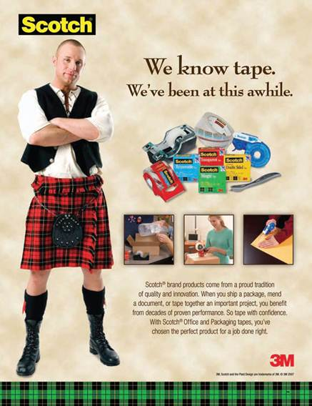
Authoritative
Expert authority
Scientific or survey evidence
Independent evidence
Business-to-business ads
Cognitive processing
Specialty print media
Notes:
When using the authoritative execution, advertisers seek to convince consumers of the product’s superiority. The most common approach is to use some type of expert authority, such as a doctor, dentist, lawyer, or electrician. Scientific evidence or even survey evidence can be used to support the claim. It works best if the evidence is independent, such as J.D. Powers & Associates or Consumer Reports. The authoritative approach is used in business-to-business ads, especially in trade journals. Authoritative executions rely on cognitive processing of the information, so work best with print media where copy can be supplied.

Slide 25
Demonstration
Shows product being used
Business-to-business sector
Television and Internet
Notes:
A demonstration execution shows how a product works. A demonstration is an effective way to communicate the benefits of a product to viewers. It is used in business-to-business advertising to show how a product can meet the needs of a business. It works best for television and the Internet.

Slide 26
Beyond reality
Common themes
Sex
Love
Romance
Perfume/Cologne
Fantasy
Notes:
Fantasy executions lift the audience beyond reality to a world of make-believe. Some are meant to be realistic, but most are fantasies that are irrational and would never really happen. The most common themes for fantasy executions are sex, love, and romance. As a result it works well for perfume and cologne. It also works well for clothing and vacation destinations. A few business-to-business ads have featured fantasies, but the danger is that customers will not take the business firm seriously.

Slide 27
Informative
Used extensively in radio
Business-to-business usage
Key is buying situation
Level of involvement
Notes:
Informative executions present information to the audience in a straight-forward manner. It is used extensively in radio, often by DJs. Informative ads are less common in television and in print. Informative ads are common with business-to-business. The key to whether individuals pay attention is the buying situation. If someone is looking for a particular product, then they may notice the informative ad. Level of involvement is important. Consumers and business buyers have to be involved at the time to notice informative ads. Placement is also important. Ads placed next to an article on the topic are more likely to be noticed.

Slide 28
Informative
A television ad for Koestler Crystal using an informative execution.
Notes:
This television ad for Koestler Crystal uses an informative execution.

Slide 29
Sources and Spokespersons
Celebrities
CEOs
Experts
Typical persons
Source
Notes:
Selecting the right source and spokesperson for an advertisement is a critical decision. Advertisers have four choices – celebrities, CEOs of companies, experts from various fields, and typical persons.

Slide 30
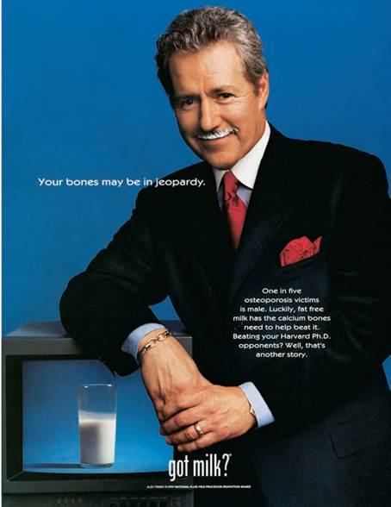
Celebrity Spokespersons
Most common
Featured in 6% of ads
Enhance brand equity
Create emotional bonds
More effective with younger consumers
Athletes popular
Establish brand personality
Notes:
The most common type of spokesperson is the celebrity. They are featured in about 6% of all ads. A celebrity can enhance brand equity and create emotional bonds with the brand. Celebrities are more effective with younger consumers than with older individuals. Athletes are a popular category of spokespersons. Celebrity spokespersons can be used to establish a brand’s personality.

Slide 31
Additional Celebrity Endorsements
Unpaid spokespersons
High level of credibility for causes
Celebrity voice-overs
Quality voice
Voice recognition
Can be distraction
Dead-person endorsements
Somewhat controversial
Becoming more common
Notes:
Three additional categories of celebrity endorsements are: unpaid spokespersons, celebrity voice-overs, and dead-person endorsements. Unpaid celebrity endorsements will sometimes occur with a charity or cause. When celebrities endorse a cause and are not being paid for the endorsement, they carry a high level of credibility. Celebrity voice-overs are used because of the quality of their voice. Sometimes it is because the voice can be recognized and will influence consumers. At other times the voice-over is a distraction because consumers pay too much attention to the voice and don’t hear the brand message. The last category, dead celebrities is somewhat controversial. It is becoming more common because they can’t bring negative publicity to themselves or the brand.

Slide 32
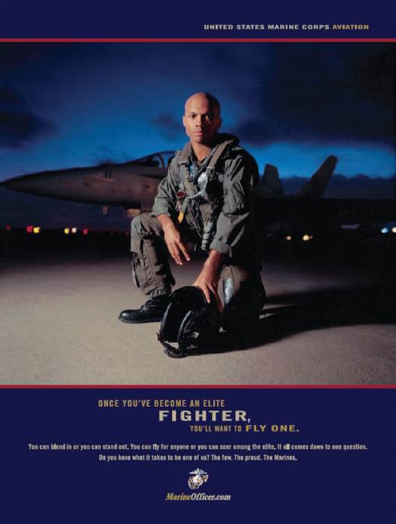
Spokespersons
CEOs
Highly visible and personable
Can be major asset
Used by local companies
Experts
Expert in their field
Authoritative figures
Typical persons
Paid actors
Typical, everyday people
Notes:
CEOs can be used as spokespersons. They work well if they are highly visible and personable. They can be a major asset to a company. They work especially well for local companies where consumers in that area know them personally, or at least have met them. Expert spokespersons should be experts in their fields. They then serve as an authoritative figure and can provide expert opinions. The last category is typical persons. It can be either paid actors who portray a typical person, or it can be everyday, ordinary people.

Slide 33
F I G U R E 7 . 6
Characteristics of Effective Spokespersons
Credibility
Attractiveness
Similarity
Likability
Trustworthiness
Expertise
Notes:
In evaluating sources, companies and ad agencies consider several characteristics. The effectiveness of the spokesperson depends on his/her degree of credibility. The level of credibility is determined by five factors – attractiveness, trustworthiness, similarity, expertise, and likability.

Slide 34
Credibility Source Characteristics
Derived from other five characteristics
Acceptance of individual and message
Believable
Most sources do not score high in all characteristics
Celebrities most likely to possess all characteristics
Notes:
Source credibility is derived from five characteristics: attractiveness, trustworthiness, similarity, expertise, and likability. Credibility determines the level of acceptance of the individual and his/her message. Credibility translates into the spokesperson being believable. Most sources do not score high on all of the dimensions. Celebrities are the most likely to possess all of the characteristics, at least to some degree.

Slide 35
Attractiveness Source Characteristics
Physical attractiveness
Personality attractiveness
Notes:
Attractiveness deals with both physical attractiveness and personality attractiveness. To be attractive, the spokesperson needs both. Someone who is physically attractive, but has a rotten personality will not be a good spokesperson. Individuals who are physically attractive will be seen as more credible than less attractive people.

Slide 36
Similarity Source Characteristics
Closely related to attractiveness
Allows for identification
Source has similar beliefs or attitudes
Preferences or behaviors similar
Aspiration similarity
Females can identify with Anna Roberts since most jockeys are male.
Notes:
Similarity is important, and closely related to attractiveness. Similarity allows for identification with the spokesperson. Identification can come from having similar beliefs, attitudes, preferences, or behaviors. Sometimes it comes from aspirations, something a consumer wants to be or has dreamed of being. Anna Roberts in this ad is seen as being similar to many females because of her gender, but also because many females like horses and some probably even dreamed of being a female jockey when they were growing up.

Slide 37
Likeability Source Characteristics
Consumers respond to sources they like
May like role an actor plays
May like an athlete because on favorite team
May like source because supports favorite cause
Transfer of dislike to brand being endorsed
Notes:
Closely related to attractiveness and similarity is likeability. Consumers respond to sources they like. That likeability can be derived in a number of different ways. If it is an actor, it may be the role they play in a TV show or movie. If it is an athlete, it may be one of their favorite players or he/she plays for their favorite team. It may be that the source supports the consumer’s favorite charity. If someone likes the source, then that liking will usually transfer to the brand being endorsed. But, if for some reason an individual does not like a spokesperson, then that dislike will transfer to the brand also.

Slide 38
Trustworthiness Source Characteristics
Not all spokespersons are viewed trustworthy
Degree of confidence or acceptance
Helps consumers believe message
Likeability and trustworthiness related
Notes:
Not all celebrities or spokespersons are viewed as trustworthy. Trustworthiness is the consumer’s degree of confidence in or acceptance of a spokesperson. Trustworthiness enhances the ability for a consumer to believe the message. Likeability and trustworthiness or closely related.

Slide 39
Most Trust Celebrities
F I G U R E 7. 7
Betty White
Denzel Washington
Sandra Bullock
Clint Eastwood
Tom Hanks
Harrison Ford
Morgan Freeman
Kate Middleton
Will Smith
Johnny Depp
Source: Adapted from “Betty White Voted America’s Most Trusted Celebrity: Poll,” Reuters, August 18, 2011, www.reuters.com/assets/print?aid=USTRE77H2WE20110818
Notes:
List of most trusted celebrities.

Slide 40
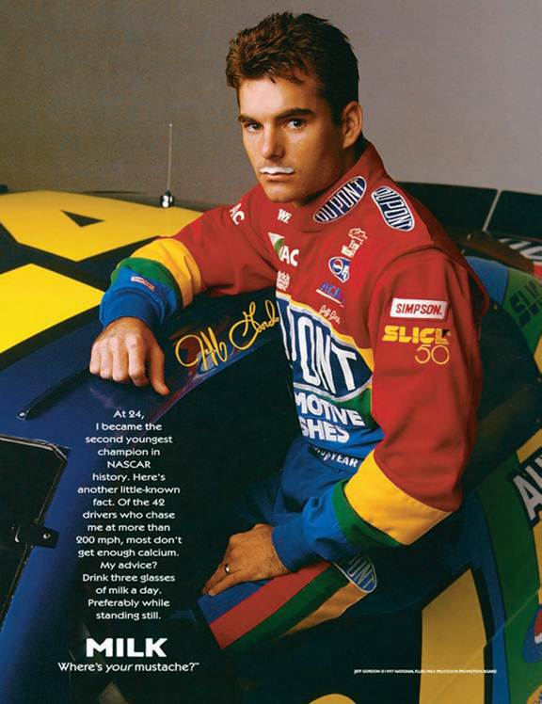
Expertise Source Characteristics
Higher expertise
Higher credibility
Notes:
Spokespersons with higher levels of expertise are viewed as being more credible. Expertise is often connected to a person’s livelihood or occupation. Jeff Gordon would be seen as an expert on products dealing with cars. He may not be seen as much of an expert for milk. But, his other characteristics may overcome a lower score on expertise, in terms of milk.

Slide 41
Matching Source Types and Characteristics
Celebrities
Tend to score high in credibility
Negative publicity
Endorsement of too many products
CEO
Trustworthy, expertise, and some credibility
Must exercise care in selection
Expert
Seek experts who are attractive, likable, trustworthy
Valid credentials important
Typical person
Multiple typical persons increase credibility
Real-person
Actor
Notes:
In choosing a spokesperson, it is important to match source types with characteristics. Celebrities tend to score high in credibility because they often score high on the other five dimensions. The risk is negative publicity and the endorsement of too many products, which lessen credibility. CEOs are typically seen as having high levels of trustworthiness, expertise, and credibility. But, not all are good on camera so an agency must exercise care when selecting CEOs. For experts, seek experts who are attractive, likable, and trustworthy. Valid credentials are important. For typical persons, using multiple typical persons in an ad increases credibility. Using 3 customers to talk about a product may better than using just one. Real people are good to use, but may not be good on television and the ad may come across poorly. Using actors helps because they are good at acting and learning lines. But, they may not appear to be real.

Slide 42
F I G U R E 7 . 8
Creating an Advertisement
Notes:
This figure illustrates the process a creative may use in designing ads. The means-end chain is at the center and is developed from information provided in the creative brief. While a creative may not draw a means-end chain out as was illustrated in this text, the creative will consider the product’s attribute, benefits, and the values it can fulfill. Decisions then must be made about the leverage point, the appeal, the message strategy and the execution. Finally, if a spokesperson is going to be used, the agency and client will need to decide who it will be.

Slide 43
F I G U R E 7 . 9
Principles of Effective Advertising
Visual consistency
Campaign duration
Repeated taglines
Consistent positioning- avoid ambiguity
Simplicity
Identifiable selling point
Create an effective flow
Notes:
Producing effective ads requires the joint efforts of the client and agency personnel. This slide lists some important principles to follow. Visual consistency across ads and across campaigns allows consumers to quickly identify an advertisement and a brand. Campaign duration is always an issue. From a cost perspective, clients want a campaign to last a long time. But, wear-out occurs and then ads are ignored. Timing for new campaigns is difficult to determine. Taglines repeated in ads helps tie campaigns together and identify a brand. It is important to use consistent positioning to avoid ambiguity and confusion. If at all possible, keep it simple. Use only one identifiable selling point. Don’t overwhelm consumers with too much information or too many benefits. Lastly, create ads that flow and are visually appealing.

Slide 44
F I G U R E 7. 10
Which Taglines Can You Identify?
Finger Lickin’ Good
Think Small
Between Love and Madness Lies Obsession
Save Money, Live Better
Innovation
Connecting People
I’m Lovin It
A Diamond is Forever
Have It Your Way
Buy It. Sell It. Love It.
Notes:
Taglines are important ways to make a brand memorable and to proclaim a product’s image or primary benefit. How many of these taglines can you identify? Answers are at the bottom of the slide. Answers: 1. KFC, 2. Volkswagen, 3. Calvin Klein, 4. Wal-Mart, 5. 3M, 6. Nokia, 7. Mc Donald’s, 8. DeBeers, 9. Burger King, 10. Ebay.

Slide 45
Beating Ad Clutter
Presence of competitor ads
Repetition
Variability Theory
Multiple mediums
Notes:
Clutter is a huge problem in advertising. If competing ads are in the same sequence of ads, then interference occurs and it is more difficult for the ad to be remembered. To beat ad clutter, use repetition. Place the ads in different environments. This is called variability theory. The varied environments increase recall and effectiveness in encoding the message. Using multiple mediums is even better. Create ads that gain attention, make them different, but make sure they relate to the target audience and speak to their needs and wants.

Slide 46
International Implications
Match culture of region
Comparison ads less common
Message strategy effects execution
Soft sell preferred in Japan
Notes:
The message strategy and execution chosen for an advertising campaign needs to match the culture. For instance, in many countries comparison ads are less common and not well received due to both social and cultural differences. It is important to make sure the message strategy fits the execution. For instance, in Japan a soft sell works best. Any type of execution that comes across as a hard sell will offend many Japanese.

Slide 47
Ouachita Independent Bank (Part 7)
ClowBaack – Integrated Campaigns in Action
Message Strategy - Affective, Resonance
Execution – Informative
Spokesperson – Chairman, CEO
Notes:
For the OIB campaign, the message strategy used in this television campaign was affective with a resonance approach. The goal was to create emotions based on trust for a bank by local people. The ad used an informative execution and the spokesperson was the Chairman, CEO, Clyde White. The ad also used a typical person in terms of the jogger.

Slide 48
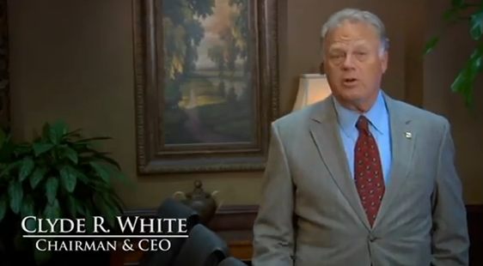
Ouachita Independent Bank (Part 7)
ClowBaack – Integrated Campaigns in Action
Attractiveness
Similarity
Likeability
Trustworthiness
Expertise
Credibility
Notes:
Discuss with students the concept of credibility of a spokesperson. Discuss the factors of attractiveness, similarity, likeability, trustworthiness, and expertise. Students will differ on how they evaluate Clyde White on these characteristics. You may also have them think about a person who is 40 or 50 and lived in the community for the entire life. Would their evaluations of credibility be different?

Slide 49
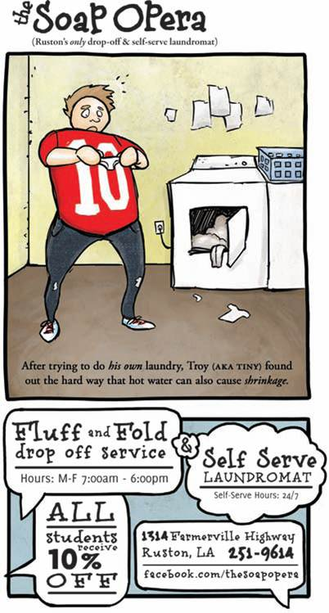
Integrated Campaigns in Action
The
Soap Opera
Notes:
The Integrated Campaigns in Action for this chapter is the Soap Opera, which is a laundry mat located in a college town. The owners of The Soap Opera met with Emogen Marketing Group to discuss the feasibility of a marketing campaign. Since it was a small business with a small marketing budget, the Emogen Group knew it would have to look at alternative ways of conveying the message that were low cost. The agency developed newspaper ads using animation and tied it in with an event on the campus of the local university.

