Slide 1
6
Chapter Six
Advertising Design
Theoretical Frameworks
and Types of Appeals
Notes:
Chapters 6 and 7 present information about advertising design. This chapter focuses on theoretical frameworks and types of appeals that can be used in advertisements.

Slide 2
mcgarrybowen
6
Founded 2002
Strategic approach
Agency of the Year – 2009, 2011
New York, Chicago, London
Full service approach
Hire and believe in people
Storytelling
Unification concept
Notes:
The mcgarrybowen advertising agency was founded in 2002 with the design to be both “gracious” and “tenacious.” Over the past decade it has picked up an impressive list of clients such as Chevron, Canon, Disney, JP Morgan, Kraft, Oscar Mayer, and Pfizer. It is a full-service agency with offices in Chicago, New York, and London. The agency believes in people and emphasis collaboration among employees and with clients. To achieve marketing goals the creative staff utilizes a storytelling approach and strategic planning. Rather than integration, the goal is unification.

Slide 3
Chapter Objectives
6
Advertising Management
How can the hierarchy of effects model and a means-ends analysis help an advertising creative design better commercials?
How can leverage points and taglines increase advertising effectiveness?
What roles do visual and verbal images play in advertisements?
What are the seven main types of advertising appeals?
Notes:
These are the objectives for Chapter 6.

Slide 4
Chapter Objectives
6
Advertising Management
How can fear be used to create an effective ad?
How can humor be used to create an effective ad?
Why does sex play such a prominent role in advertising?
How can music, rationality, and scarcity be used to increase advertising effectiveness?
What are the primary areas of concern in international advertising?
Notes:
Additional objectives for Chapter 6.

Slide 5
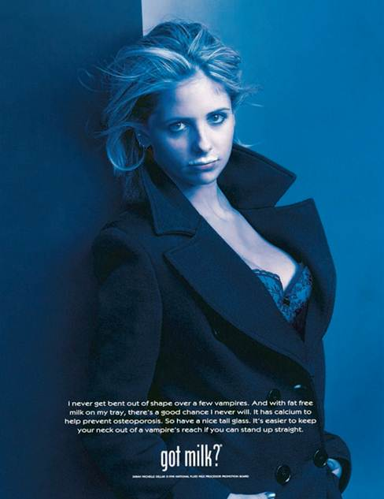
Chapter Overview
Advertising Design:
Theoretical Frameworks and Types of Appeals
6
Advertising design theories
Hierarchy of effects model
Means-end theory
Visual and verbal imaging
Advertising appeals
Notes:
The first part of the chapter examines three major advertising design theories – the hierarchy of effects model, means-end chain theory, and visual and verbal imaging. The last part of the chapter presents and discuses advertising appeals that can be used.

Slide 6
Adweek Media and Harris Interactive Survey
Ads somewhat or very interesting (55%)
Ads not interesting at all (12%)
Ads very influential in purchase decisions (6%)
Ads somewhat influential in purchase decisions (29%)
Nearly half of 18-34 year-olds influenced by advertising
37% of 35-44 year-olds influenced by advertising
28% of individuals 45+ influenced by advertising
Notes:
Adweek Media and Harris Interactive conducted a survey of consumers about their attitudes toward advertising. 55% said ads were somewhat or very interesting compared to only 12% who said advertising was not interesting at all. About 6% said ads were very influential in the purchase decisions they made and 29% said ads were somewhat influential in purchase decisions. About half of the survey respondents in the 18 to 34 year-old age bracket were influenced by advertising. The percentage dropped to 37% for individuals 35 to 44 and 28% for individuals 45 and older.

Slide 7
Hierarchy of Effects Model
Awareness
Knowledge
Liking
Preference
Conviction
purchase
Notes:
The hierarchy of effects model consists of these six steps.

Slide 8
Hierarchy of Effects Model
Steps are sequential
Some question if sequential
Consumers spend time at each step
Brand loyalty involves all six steps
Similar to attitude formation
Cognitive → affective → conative
Cognitive – awareness, knowledge
Affective – liking, preference, conviction
Conative – actual purchase
Notes:
The six steps are sequential, although some experts question if they are really sequential. But, the basic model says they are sequential and that consumers spend some time at each step. For instance, before a consumer can like a brand, they first must be aware of it and develop some knowledge of it. To develop brand loyalty, consumers must go through all six steps. It is similar to attitude formation and the cognitive-affective-conative sequence. Cognitive component of attitude is the awareness and knowledge. Affective component of attitude is the liking, preference, and conviction. Conative component of attitude is the purchase.

Slide 9
Hierarchy of Effects Model
Cognitive
Awareness
Affective
Knowledge
Conative
Liking
Preference
Conviction
Purchase
Notes:
This model shows the relationship between the hierarchy of effects model and attitude sequence formation.

Slide 10
F I G U R E 6 . 1
Personal Values
Comfortable life
Equality
Excitement
Freedom
Fun, exciting life
Happiness
Inner peace
Mature love
Personal accomplishment
Pleasure
Salvation
Security
Self-fulfillment
Self-respect
Sense of belonging
Social acceptance
Wisdom
Notes:
Personal values was presented in Chapter 4. In designing ads, it is important to remember people have values and much of their consumption behavior is motivated by a desire to fulfill these values in their lives.

Slide 11
Means-End Theory
Means-end chain
Message (means) lead to end state (personal values)
Means-End Conceptualization of Components of Advertising Strategy (MECCAS)
Model suggests six elements
Product attributes
Consumer benefits
Leverage points
Taglines
Personal values
Executional framework
Notes:
The second theory that it is important to consider is means-end theory. The basic concept is that a means, the message, leads to an end-state, or personal value. The actual name of the theory is “Means-End Conceptualization of Components of Advertising Strategy”, or MECCAS. The model suggests six elements that are critical to ad design. Product attributes lead to consumer benefits. The leverage point connects that benefit to the personal value. Taglines are used to make an important and memorable point about the product. The executional framework is presented in Chapter 7 and provides the foundation for the ad.

Slide 12
Means-End Chain
Product
Attributes
Executional Framework
Leverage
Point
Consumer
Benefits
Personal
Value
Notes:
In designing an ad, a creative will begin with product attributes. The question that is asked, is what benefits do those attributes provide to consumers, because consumers do not purchase attributes, they purchase benefits. Women buy cosmetics for how it makes them look, not for the ingredients that are in them. Using a leverage point and an execution design, creatives take those benefits and show how they can fulfill a consumer’s personal values. While it looks simple, it is not. The magic is the creation of the leverage point and executional framework that will connect benefits to personal values.

Slide 13
F I G U R E 6 . 2
Means-End Chain for Milk
Notes:
This figure illustrates a means-end chain for milk. An attribute in milk, low fat, can provide the benefit of health. The personal values consumers receive from good health are self-respect and wisdom. Another attribute, calcium, provides the benefit of healthy bones, which in turn leads to a comfortable life and shows wisdom on the part of the consumer. The key to a means-end chain is looking at the benefits each attribute generates then connecting those benefits to various personal values.

Slide 14
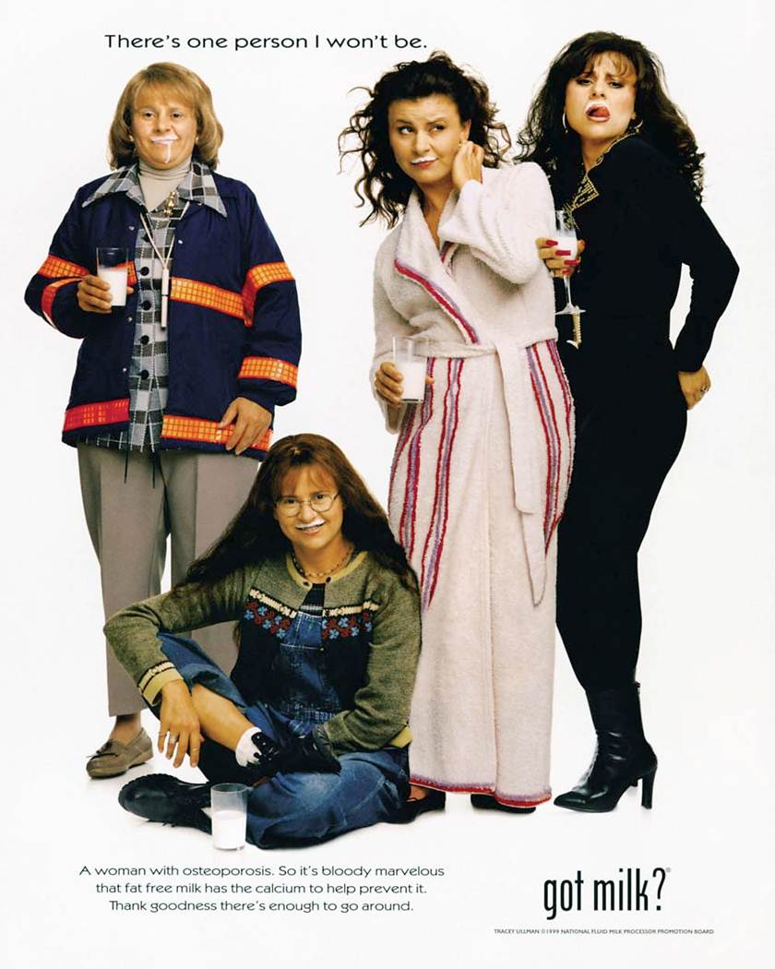
Notes:
This advertisement for milk illustrates the last means-end chain. The specific message is that milk can help prevent osteoporosis, a bone disease.

Slide 15
F I G U R E 6. 4
B-to-B Means-End Chain for Greenfield Online
Notes:
This is a means-end chain for a business-to-business firm, Greenfield Online. The company is promoting marketing research. The first attribute is that Greenfield Online does marketing research using the Internet which provides the benefit of robust samples. For a marketing person in a company, using robust samples can provide job security. Another aspect of the service, speed, offers quicker results. This can provide the benefit of self-fulfillment since the information needed is provided quickly. Other personal values that are tapped through the benefits suggested include social acceptance and wisdom.

Slide 16
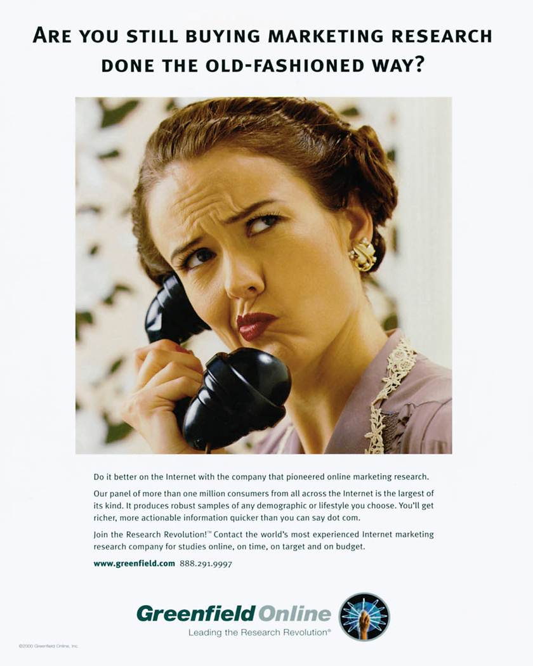
Notes:
This is the ad for Greenfield Online based on the previous means-end chain. Notice the ad talks about not using old fashioned methods, but the Internet to conduct research.

Slide 17
Leverage Points
Moves consumer from benefits to personal value
Links attributes – benefits – personal values
Associated with attitude change
Ads need powerful leverage points
Notes:
Leverage points are important. They move consumers from the benefits to the personal values. It links attributes to benefits to personal values. The leverage point should be associated with some component of attitude change. To be effective, ads need powerful leverage points. The leverage point can be a visual, part of a visual, a headline, a tagline or even copy in the ad. Most creatives spend considerable time thinking about and creating a good leverage point.

Slide 18
Taglines
Key phrase in an advertisement
Memorable
Identify uniqueness or special meaning
Provide consistency
Taglines identified with specific brands
Catchy taglines transcend campaigns
Developing new taglines
Notes:
Taglines are key phrases in an advertisement. They are designed to be memorable, unique, and offer a special meaning about the brand. Taglines can provide consistency across ads and across advertising campaigns. Taglines become identified with a specific brand and transcend any specific ad or ad campaign. Developing good taglines is important because it lives with that brand and is around a long time, such as Nike’s tagline “Just Do It.” While taglines can be changed, companies have to be careful not to confuse customers and convey conflicting messages about the brand.

Slide 19
Tagline for Philadelphia Cream Cheese
“Pheel the moment”
Notes:
When Kraft launched their new ad campaign for Philadelphia Cream Cheese, the mcgarrybowen advertising agency spent considerable time finding just the right tagline that could be used in all of their ads and convey the message desired by Kraft. The tagline “Pheel the moment” was chosen because it conveyed the message that Philadelphia Cream Cheese can be used anytime and generate good feelings and good moods.

Slide 20
Verbal and Visual Elements
Balance between visual and verbal
Visual processing
Easier to recall
Stored both as pictures and words
Concrete vs. abstract
Radio visual imagery
Visual esperanto
International ads
B-to-B advertisements
Notes:
The last theory of design to be considered is the relationship between the verbal and visual elements of an advertisement. Most ads seek to have a balance between visual and verbal, but usually one will be more dominant than the other. In recent years, advertisers have seen a move to more visuals and less of an emphasis on verbal content. One reason for the change is that visual processing is easier for consumers to recall. Visuals are stored in the brain both as pictures and as words. Concrete images tend to be remembered better than abstract visuals. If consumers can create a mental image or picture, it actually is superior to seeing the visual, in terms of recall. So radio ads that can make listeners use their imagination and picture the product work very well. Visual esperanto is the ability of a visual to transcend cultures and languages conveying the same meaning. It is especially beneficial in international ads where advertisers want to convey the same message to every market in the world. Business-to-business ads in the past emphasized verbal content, but in recent years have moved to more visuals.

Slide 21
F I G U R E 6. 5
Types of Appeals
Fear
Humor
Sex
Music
Rationality
Emotions
Scarcity
Notes:
Advertisers have seven different types of appeals they can use. The type of appeal chosen should be based on the creative brief and the objectives of the ad campaign. If a means-end chain has been developed, then ideas on which appeal would work the best can be generated. While almost any appeal can work in any situation, some appeals would be more appropriate than others. In some cases, a particular appeal may be unacceptable to the target audience or to the client.

Slide 22
Fear Appeal
Fear appeals are common
Fear increases interest and is remembered
Severity and vulnerability
Severity – level of consequence
Vulnerability – probability of event occurring
Response efficacy
Intrinsic reward
Extrinsic reward
Response costs
Self-efficacy
Response efficacy
Notes:
Fear appeals are common and are used for products ranging from insurance, to home security systems, to deodorant. Fear appeals increase interest and are remembered by individuals. Severity is the level of consequence that will occur and vulnerability is the probability of the event happening. Response efficacy is the likelihood that a change in behavior or actions will result in a desirable positive consequence. Intrinsic reward is the internal satisfaction and extrinsic reward is the value of the event or reward received. Response cost is the cost or sacrifice the person will need to make to obtain the reward. Self-efficacy is the confidence a person has in his/her own ability to engage in the action, or to stop an undesirable behavior. All of these factors influence the effectiveness of an ad using a fear appeal.

Slide 23
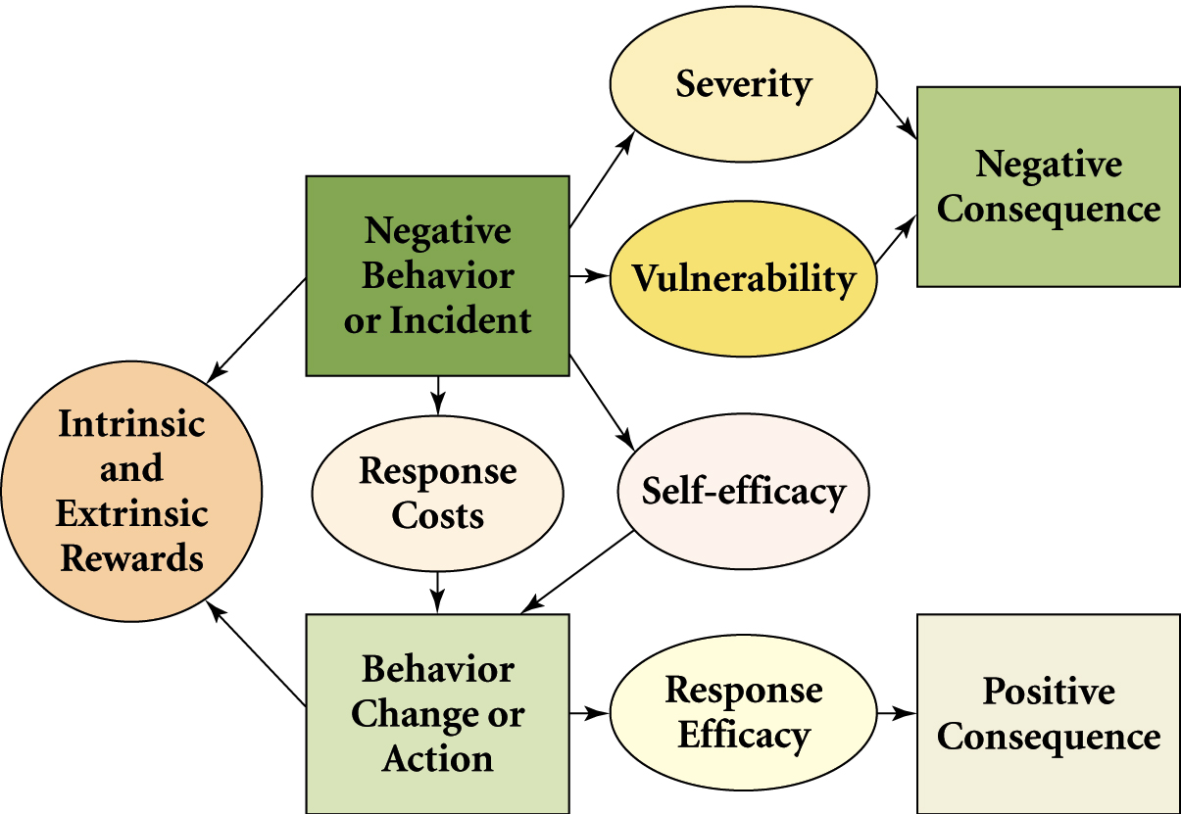
F I G U R E 6 . 6
Behavioral Response Model
Notes:
The behavioral response model explains how fear appeals work. For a product, such as a home security system ad can focus on severity, what happens when a home is broken into, or the vulnerability, which would be the probability of it actually occurring. The ad can show the negative consequence of such an event. An ad can show the intrinsic and extrinsic rewards from installing a security system. Response efficacy can be illustrated by the alarm going off when a burglar tries to enter and the police are called. Peace of mind and security are then shown as the positive consequence.

Slide 24
Fear Appeal
Appeal strength
Low – not noticed
High – ignored
Moderate – works best
Notes:
This ad uses a fear appeal to show the negative consequences (severity) of too much sun exposure to children before the age of 18. If the intensity is too low, the ad is ignored and the consequence is not seen as negative. Research has shown that if the fear intensity is too high, individuals tune out the ad, also ignoring it. A moderate level of fear intensity works the best. Does it use just the right amount of fear intensity?

Slide 25
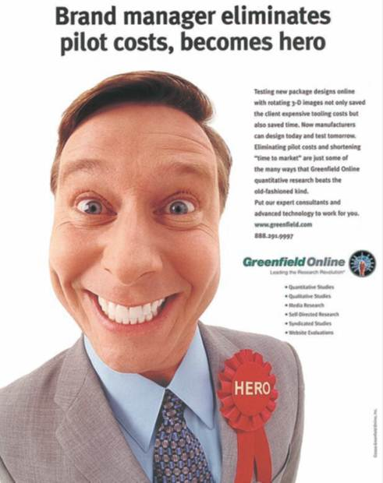
Humor Appeal
Excellent for getting and keeping attention
Used in 30% of TV and radio ads
Humor causes consumers to
Watch
Laugh
Remember
Notes:
Humor is an excellent appeal for getting and keeping someone’s attention. Humor is used in about 30% of television and radio ads. Humor causes individuals to stop what they are doing, watch, laugh at, and then remember the ad. In recall tests, consumers most often remembered humorous ads over ads with other types of appeals. The best results occur when the humor is connected naturally with the product.

Slide 26
Humor Appeal
Advantages of humor
Piques interest
Increases recall and comprehension
Elevates mood
Problems with humor
Offensive
Overpower message
Humor should focus on product
International usage
Humor often rooted in culture
Humor varies across countries
Good humor difficult to achieve
Notes:
Humor appeals offer a number of advantages. Humor piques consumer interest. Humor increases recall and comprehension of ads. Humor elevates people’s moods, and if people feel good about an ad, they will tend to think positively about the brand being advertised. Problems occur when the humor is offensive or overpowers the message. At times, people can recall an ad and describe it in detail, but not remember the brand being promoted. When that occurs, the ad has failed. To prevent the humor from overpowering the message, the humor should focus on the product and not stand alone. Humor is rooted in culture and so what is funny in one country is not likely to be funny in another. Good humor that is remembered and that is connected with the brand is difficult to achieve.

Slide 27
F I G U R E 6 . 7
Reasons for Using Humor in Ads
Captures attention
Holds attention
Often wins creative awards
High recall scores
Consumers enjoy funny ads
Evaluated as likeable ads
Notes:
Advertisers use humor because it works. It captures attention. It holds people’s attention. Humor often wins creative awards at competitions. Humor produces a high level of recall on recall tests. People enjoy humor, they like to laugh. When comparing ads, most people evaluate humorous ads as ones they like best.

Slide 28
F I G U R E 6 . 8
Sexuality Approaches
Subliminal techniques
Sensuality
Sexual suggestiveness
Nudity or partial nudity
Overt sexuality
Notes:
Advertisers have five different approaches they can use with sex appeal. They range from very subliminal messages to overt sexuality.

Slide 29
Sex Appeal
Breaks through clutter
Use has increased
Not as effective as in the past
Advertisers shifting to more subtle sexual cues.
Notes:
Sex appeals are often used to break advertising clutter. The use of sex appeals has increased in the United States and in many other countries. The problem is that sex appeals may not carry the impact they used to because children are growing up exposed to sexual themes all around them. As a result, many advertisers are moving to more subtle sexual clues and a softer sexual approach. This ad uses a sex appeal with the female model and the tagline that by drinking Old Orchard, it will be “forever on the lips, never on the hips.”

Slide 30
Subliminal Approaches Sex Appeal
Sex cues or icons placed in ads
Goal is to affect subconscious
Not effective
Ad clutter requires stronger ads to get attention
Notes:
Placing sexual cues or icons in an advertisement with the idea of affecting the subconscious is subliminal advertising. The cue or icon should not be easily noticeable. Research has shown that subliminal advertising does not work. It is not effective. If it did, there would not be a need for overt sexual advertising. Ad clutter requires stronger ads that get attention.

Slide 31
Sensuality Approaches Sex Appeal
Women respond more favorably
More sophisticated
Relies on imagination
Images of romance and love can be enticing
Notes:
The sensuality approach conveys sex, but in a loving, romantic way. Women respond more favorably to a sensuous approach. It is viewed as more sophisticated and relies on a person’s imagination. Because it relies on imagination, the viewer can put their own positive spin on what they think will occur. Images of romance and love can be more enticing to viewers of an ad than raw sexuality.

Slide 32
Sexual Suggestiveness Sex Appeal
Hints about sex
This Finnish ad, promoting tourism to Helsinki, stays away from overt sexuality
Instead, it focuses more on sexual suggestiveness
Notes:
Sexual suggestiveness is a stronger hint about having sex, or a sexual theme. For instance, this ad hints at the fact that Bo Derek is completely naked, except for the Bijan perfume. Recent ads have focused on women watching men who were shirtless or near nude, suggesting sexual fantasies that could occur with the man.

Slide 33
Nudity or Partial Nudity Sex Appeal
Used for wide variety of products
Attract attention
Not always designed to elicit sexual response
Underwear commercials
Decorative models
Notes:
Nudity and partial nudity is used in advertising for a variety of reasons and used for a wide variety of products. Some are products related to sex, others have nothing at all to do with sex. One primary reason nudity and partial nudity is used in ads is to attraction attention. It is not always designed to elicit a sexual response. For instance, underwear commercials may be just promoting their garments, not trying to convey the idea that their underwear is sexy. When nude models are used with products not related to sex, then they become a decorative model with the sole purpose of attracting attention.

Slide 34
F I G U R E 6 . 9
Factors to Consider Before Using Decorative Models
Improves ad recognition, not brand recognition
Influences emotional and objective evaluations
Produces higher purchase intentions when the product is sexually relevant
Attractive models produce a higher level of attention than less attractive models
Notes:
Before using a decorative model, companies should consider several factors. First, using decorative models does improve ad recognition, but it does not improve brand recognition. Recalling the ad, but not the brand is not good. Second, decorative models influence emotional and objective evaluations of the product for both male and female audiences. Third, decorative models produce higher purchase intentions when the product is sexually relevant. Fourth, attractive models produce higher levels of attention than less attractive models, for both males and females.

Slide 35
Overt Sexuality Sex Appeal
Acceptable for sexually-oriented products
Used to break through ad clutter
Often used for a shock effect
Danger of being offensive
Notes:
Overt sexuality in ads is acceptable for sexually-oriented products. It can be used to break through ad clutter. It is often used for shock value, to get people’s attention. The major danger of an overt sexual approach is that it can offend people. When that occurs, it creates a negative image and attitude towards the brand.

Slide 36
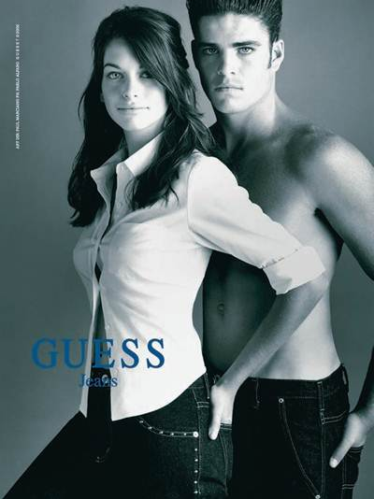
Are Sex Appeals Effective?
Attracting attention
Sexually-oriented ads do attract attention
Attention greater for models of opposite gender
Brand recall is lower
Sexual theme often distracts from brand name
Normally rated more interesting
Controversial ads
Interest increases
Fail to transmit ad information
Notes:
The big question clients ask—are sex appeals effective? They do attract attention. Attention is greater for models of the opposite gender. For example, for male consumers female models attract greater attention and for females, male models attract more attention. Research has shown, however, that brand recall is lower. Sexual themes appear to distract from the brand name of the product being advertised even though sexually-oriented ads are rated higher by consumers. Controversial ads seem to attract the most attention, but normally fail to transmit ad information. So using sex appeal for shock value may not actually work in terms of brand and information recall.

Slide 37
Are Sex Appeals Effective?
Physiological arousal
Overt sexual cues or nudity increases arousal
Affective and cognitive responses
Higher for opposite genders
Cognitive impressions
Depends on viewers view of ad
Like ad – positive cognitive impression of brand
Dislike ad – negative cognitive impression of brand
Notes:
Are sex appeals effective? Overt sexual ads, overt sexual cues, and nudity does increase physiological arousal. Ads with sexual appeals produce both affective and cognitive mental responses. These responses are higher when the model in the ad is of the opposite gender from the viewer. The cognitive impressions made in ads with sex appeals vary depending on the viewer. If the person likes the ad, then a positive cognitive impression is made of the brand. If they dislike the ad, then a negative cognitive impression is made of the brand.

Slide 38
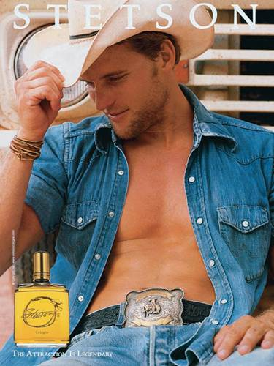
Are Sex Appeals Effective?
Societal trends
Consider society’s view of sex
Attitude towards sex cycles over time
High level of tolerance early 2000s
Super Bowl of 2003 – Janet Jackson
Tolerance level declined
Pendulum swinging back
Notes:
Are sex appeals effective? Advertisers must consider societal trends. This is especially important for global brands and the use of sex appeals in various countries. Society attitude towards sex tends to cycle over time from a wide acceptance of sexual themes to a low tolerance of sexual themes. In the early 2000s, there was a high level of tolerance in the U.S. towards sex in advertising. Then during the Super Bowl of 2003 Janet Jackson’s breast was accidentally (although some contend on purpose) shown on live television during the Super Bowl half time show. Tolerance of sex in advertising quickly swung the other way and ads became more conservative and less sexual themes were used. Now the pendulum is slowly swinging back to more tolerance of sexual themes in advertising.

Slide 39
Disadvantages of Sex Appeals
Less influence today
Reduces brand recall
Affects comprehension
Creates dissatisfaction with one’s body
Females
Males
Stereotyping of females
Notes:
Sexual appeals in advertising is not all positive. A number of disadvantages are present. Using sex in advertising today has less influence because sex is common on television and in movies. Sexual themes interfere with brand recall and affect ad comprehension. A negative societal consequence is that it appears to cause a greater dissatisfaction with the viewer’s own body. Females feel they are too fat. Males feel they are not strong enough, not muscular. It also has led to stereotyping problems with females.

Slide 40
Sex Appeals in International Advertising
Varies across countries
Determined by religion, culture, and values
Moslem countries
Middle eastern countries
European countries
France
United States
Chile
Notes:
What is deemed appropriate varies across countries. It is determined by the religion, culture, and values of each region. For most Muslim and Middle Eastern countries, sex and gender issues are taboo subjects. Sexual appeals are not used in advertising. In fact, visuals of males and females showing affection are not appropriate. In Europe views of sexual appeals are very similar to the United States. In France, advertising can feature seminude and nude models if they can be justified in terms of some type of relationship with the product. In Chile, an ad campaign using nude models was used by the Chile Dairy Federation. Adults fought the campaign saying it would corrupt teenagers and children. As sex becomes more common throughout the world, the acceptance of sexual images in advertising is becoming more accepted.

Slide 41
Music Appeals
Connects with emotions and memories
Has intrusive value
Gains attention
Increases the retention of visual information
Better recall
Can increase persuasiveness
Stored in long-term memory
Notes:
Music is an important part of advertising. It connects with emotions and generates memories. It has intrusive value and gets attention. Music increases the retention of visual information. It produces higher recall scores and can increase persuasiveness. Music tends to be stored in long-term memory and consumers often tie a particular music or song with a particular brand of product.

Slide 42
Music Appeals
Design Questions:
What role will music play?
Will a familiar song be used or new song created?
What emotional feeling should song elicit?
How does the music fit with the message of the ad?
Notes:
When selecting music for ads, creatives have to consider these questions: What role will the music play? Should it be a song people are familiar with or should a new song be written? What emotional feelings should the song elicit. How does the music fit with the message of the ad?

Slide 43
Music Appeals
Variety of roles in advertisements
Incidental to ad
Primary theme
Selecting the music
Familiar tune
Write a jingle
Background or mood music
Solicit music for an advertisement
Notes:
Music can play a variety of roles in ads. It can be incidental to the ad, hardly noticed by viewers or it can be the central theme of the ad. The role it will assume impacts the type of music that will be selected. Advertisers can use a familiar tune, or they can write a jingle or new song. Music can be for background or to create a certain mood as the ad progresses. In recent years, advertisers have solicited musicians to create songs for ads rather than purchase familiar tunes and adapt them to the ad.

Slide 44
Music Appeals
Advantages of music appeals
Consumers have affinity with existing songs
Brand awareness, brand equity, and brand loyalty become easier
Emotional affinity transference to brand
Popular songs expensive
Alternative methods
Musicians see ad songs as way to be heard
Songs posted on YouTube and other sites
Occasionally full song becomes popular
Notes:
Music appeals offer a number of advantages. Consumers have an affinity with existing songs so when an existing song is used, consumers have already heard it and most have developed emotions with it. Brand awareness, brand equity, and brand loyalty become easier with music appeals. Even for new songs, such as “It Doesn’t Get Better Than This” consumers transfer affinity and positive feelings from the song to the brand. One reason mcgarrybowen sent a creative brief to musicians and asked them to write a song is that to purchase the rights to current popular songs can be extremely expensive. Musicians have become more open to writing and performing songs for ads. It is a way to be heard. Songs are often posted on YouTube and other sites. Occasionally, the full song version of a tune written for an ad will become popular and move to radio stations and other popular outlets for music.

Slide 45
Rational Appeals
Based on hierarchy of effects model
Active processing of information
Media outlets
Print media and Internet best mediums
Business-to-business
Print media, trade publications
Information search by buying center members
Product attributes
Complex and high involvement products
If processed, excellent at changing attitudes
Notes:
Rational appeals are based on the hierarchy of effects model and the sequence of steps outlined in the model. It implies active processing of information. Rational appeals work best for print ads where longer copy can be inserted and online where there is very little limit to what copy can be inserted. Rational appeals are common in business-to-business ads, again in print media, especially trade publications. When members of the buying center are searching for information, ads using rationale appeals can be effective. Rationale appeals work well for complex and high involvement products. If a person processes the information in a rationale ad, it is excellent at changing attitudes. The key is will consumers stop and look or listen to the ad and process the information?

Slide 46
F I G U R E 6 . 10
Reasons for Using Emotional Appeals
Consumers ignore most ads
Rational ads go unnoticed
Emotional ads capture attention
Notes:
Advertising creatives have a wide range of emotions from which to choose. It can be love, trust, anger, or any of the other emotions shown on this slide.

Slide 47
Emotional Appeals
Brand loyalty
Key to developing brand loyalty
Creates bond with brand
Business-to-Business
Used more frequently (25%)
Emotions important in business decisions
Media outlets
Television best medium
Internet
Work well when tied with other appeals
Notes:
Most advertising creatives believe that emotions are the key to developing brand loyalty. Emotions and feelings will create bonds with a brand. Emotional appeals are becoming more common in B-to-B advertising. It is now used in about 25% of all business ads. The rationale is that business buyers are people also, and even in business decisions emotions are an important component of the decision. Emotional appeals work really well for television where people can see and hear the emotions. It works well for the Internet. Emotional appeals work well with other types of appeals and is often combined with other appeals, such as with humor.

Slide 48
Scarcity Appeals
Based on limited supply
Based on limited time to purchase
Often tied with promotion tools such as contests, sweepstakes, and coupons
Encourages customers to take action
Notes:
Scarcity appeals urge consumers to make a purchase now because of some type of limitation. Often that limitation is limited supply so the product must be purchased before they are all gone. It can be based on limited time. You only have 5 days or one week, or just one hour. Scarcity appeals are often tied to other promotions such as contests, sweepstakes, and coupons. The concept is to encourage customers to take action, now, and not wait, or it will be too late.

Slide 49
Scarcity Appeals
A Television ad by Diamond Security using a scarcity appeal.
Notes:
Diamond Security uses a scarcity appeal in this ad because it states it is “a limited time offer, so call now.”

Slide 50
Ouachita Independent Bank (Part 6)
ClowBaack – Integrated Campaigns in Action
Hierarchy of Effects – Liking, preference
Leverage point – Dog (trust, rely)
Tagline – Local bank, local trust
Advertising appeal - Emotions
Notes:
After showing this television ad, discuss the hierarchy-of-effects model, leverage point, tagline, and advertising appeal used in the design of this television ad.

Slide 51
Integrated Campaigns in Action
Philadelphia
Cream
Cheese
Notes:
The Integrated Campaign in Action is about Philadelphia Cream Cheese. The sales of Philadelphia Cream Cheese had stagnated in the United States. Focus groups and other research indicated people saw Philly cheese as a spread for bagels and for making cream cheese cake. Brand manager Howard Friedman and Kraft’s agency mcgarrybowen realized they needed to expand the use of Philly cheese. The new campaign focused on women and how Philadelphia cream cheese could be used in cooking to enhance even common dishes. The campaign focused on providing recipes to women, a contest called “Real Women of Philly”, a print campaign, and series of new television ads.

